Slide 1

Curso Estructura y Función de Proteínas
Bioquímica de Moléculas Individuales
Christian A.M. Wilson
yitowilson@gmail.com
2023

Slide 2
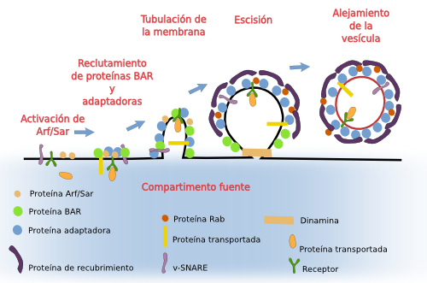
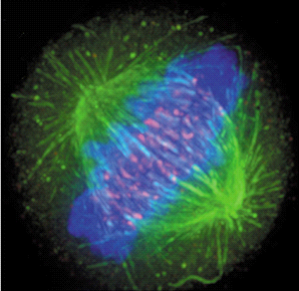
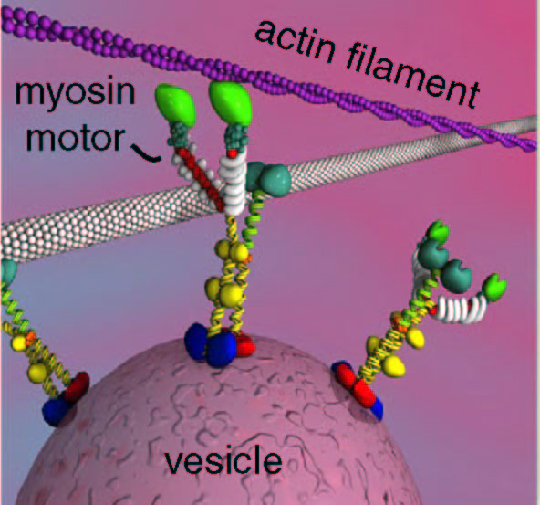
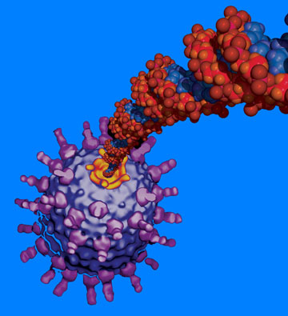
Proteínas expuestas a fuerzas mecánicas in vivo
Liberación de vesículas
Separación de cromosomas
Motores moleculares
Empacamiento de virus

Slide 3
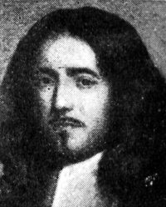
La célula como una fábrica de máquinas moleculares
“The operative industry of Nature is so prolific that
machines will be eventually found not only unknown to
us but also unimaginable by our mind.”
Marcello Malpighi (de Viscerum Structura, 1666)
Marcello Malpighi, 1628 – 1694
“Nihil novum sub sole”

Slide 4
Estudios de una molécula v/s muchas moléculas
Muchas moléculas (in multiplo)
  Robustos
  Medidas poblacionales y promediadas
  Poblaciones deben ser homogéneas
Una molécula (in singulo)
  Fluctuaciones
  Comportamiento estocástico
  Moléculas pueden encontrarse lejos del comportamiento del promedio
  Poblaciones no homogéneas
  Pausas y retrocesos

Slide 5


Slide 6
Por qué estudiar a nivel de moléculas individuales
One molecule in an E. coli cell (about 1 μm³ in volume) is at a concentration of ~ 1.6 nM.

Slide 7
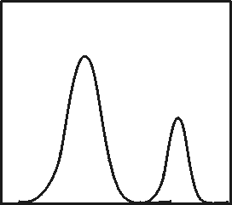
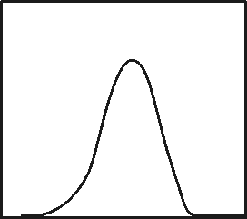
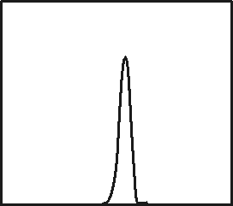
Poblaciones multimodales
Averages can be misleading. When you measure a molecular
property of an ensemble of molecules you may be looking at a
homogeneous population or the molecules may exist in more
than one form:
A <========> A’
2 populations
Single population (broad)
Single population (narrow)
# molecules
<averaae>
<average>
<average>
Molecular property

Slide 8
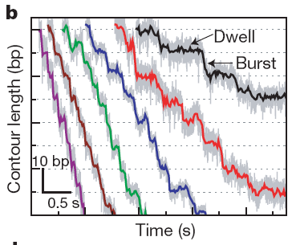
Pausas
Cell (2011) 144:480

Slide 9
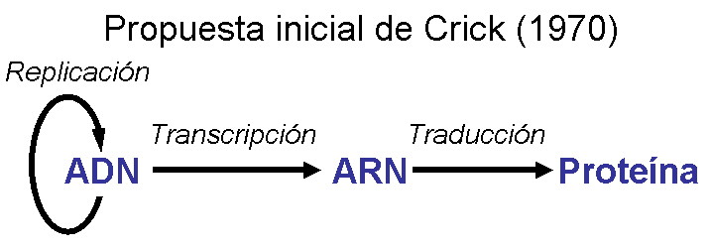
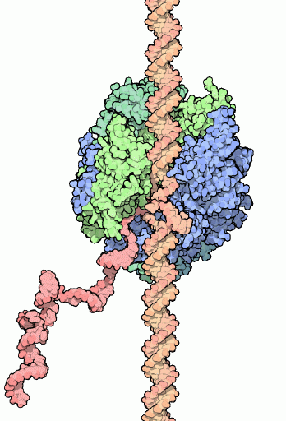
Ejemplo de medición de actividad
RNA
polimerasa
ADN
Producto
ARN
tiempo

Slide 10
Importancia de los retrocesos
Mejia et al. (2008) J Mol Biol 382, 628
Notes:
One new field in biophysics is the study of individual molecules. Studying single molecules has revealed great molecular detail on the mechanism of enzymatic activity.
For instance, optical tweezers has been used to study molecular motors. Here I am displaying one example that is relevant to this project, in which we are able to monitor the transcription activity of a single RNA polymerase molecule from E. coli.
How do we do this experiment?
What do we measure? Cambios de extension en funcion al tiempo.
On the right hand side I am showing a typical trace of the transcription activity of RNA polymerase of E. coli. As you can, transcription is not a continuous process. In fact, it is interrupted by pauses. This pauses are of different duration and occur stochastically. Therefore, with this technique we can observe different dynamic behaviors of the enzyme during transcription. This type of information is very hard to obtain using traditional bulk experiments.
Having this type of information, then we can identify the mechanism by which transcription is slowed down due to rifampicin binding. Is it by decreasing the velocity of the transcript? Or is it by increasing the duration of the pauses? Or is it by increasing the frequency of pauses? Or any combination of these potential effect? All of them will result into the slowing down of the enzyme, but by different mechanisms?

Slide 11
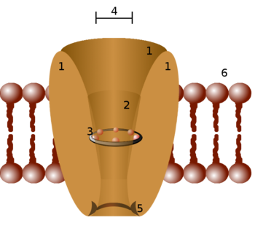

Primeros estudios de moléculas individuales
Profesor Ramón Latorre
http://cinv.uv.cl/en/ramon-latorre-2/
Latorre et al.

Slide 12
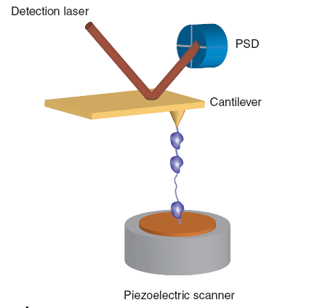
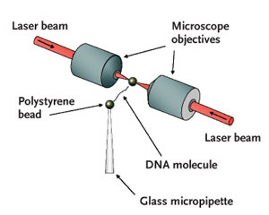
Diferentes métodos de manipulación de moléculas individuales y aplicación de fuerza
Pinzas magnéticas
Microscopía de fuerza atómica
Pinzas ópticas
Nature Methods (2008) 5:491

Slide 13
Pinzas ópticas

Slide 14
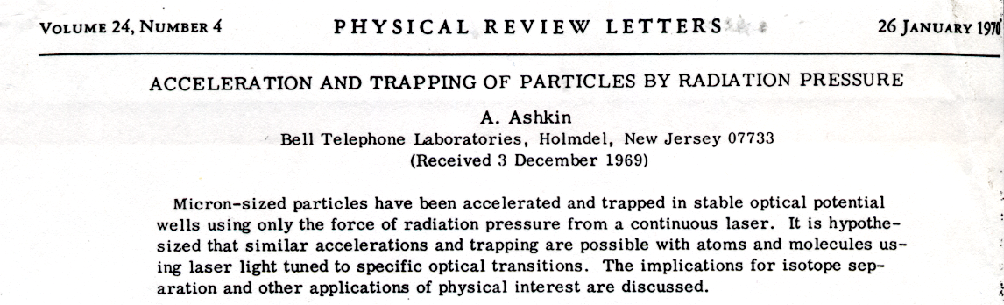
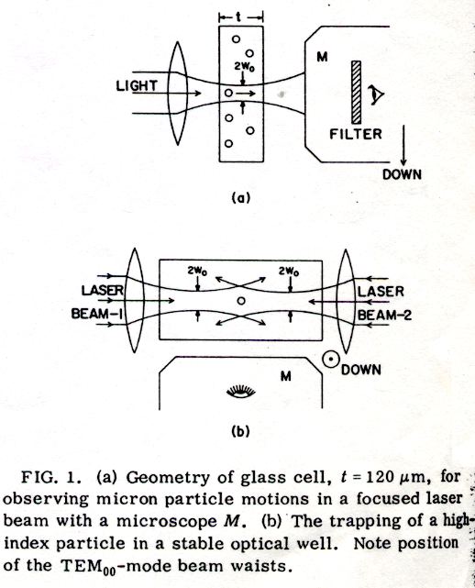
Arthur Ashkin construyó las primeras pinzas
1970
Axial escape
Single-beam trap
Dual-beam trap

Slide 15
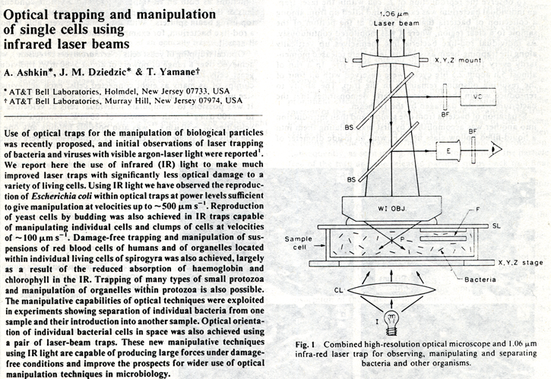
Atrapamiento de células
Trap live
bacteria
Sort living
cells
Manipulate
organelles
inside cells
Nature, 1987

Slide 16
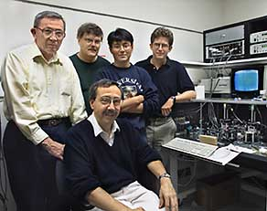
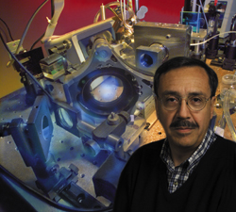
Aplicaciones biólogicas con pinzas ópticas y estudios in singulo
Ignacio Tinoco, Steve Smith, Bibiana Onoa, Jan Liphardt, Carlos Bustamante
http://www.lbl.gov/Science-Articles/Archive/busta-rna.html
Prof. Carlos Bustamante
http://www.lbl.gov/Science-Articles/Research-Review/Highlights/2002/stories/biosciences/mighty.html
http://alice.berkeley.edu/

Slide 18
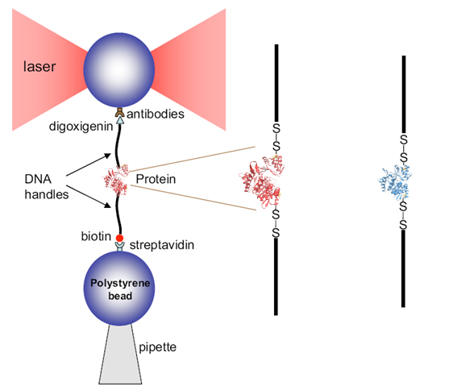
Diseño experimental
ADP
Mutante
S4CT57C
Modified from Cecconi et al., Eur. Biophys. J. 37, 729-738, 2008

Slide 19
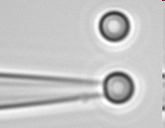
Diseño experimental
The Scientist (2005) 19:26

Slide 21
Estiramiento típico de molécula de ADN

Slide 22
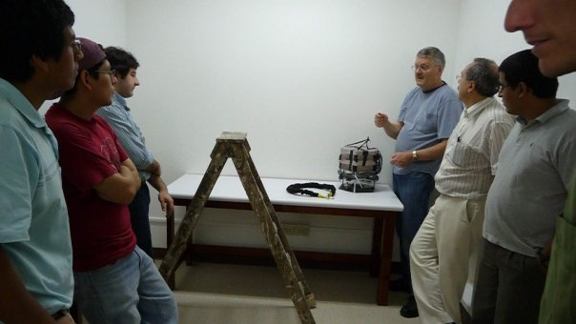
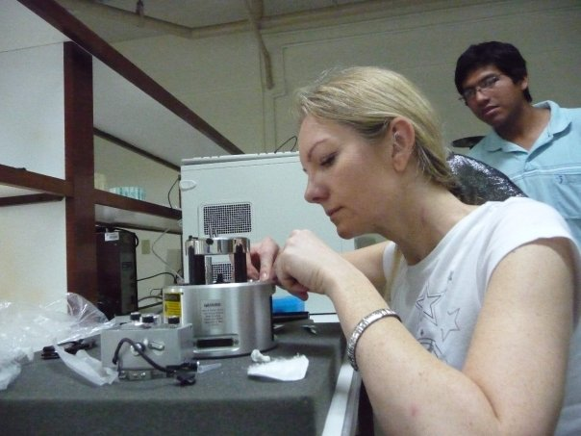
Instalación de laboratorio en Perú
Optical tweezers instrument
Atomic force microscope instrument
Laboratorio de Moléculas Individuales in Universidad Cayetano Heredia, Peru
It is directed by Professor Daniel Guerra.

Slide 23
Obtención de parámetros termodinámicos

Slide 24
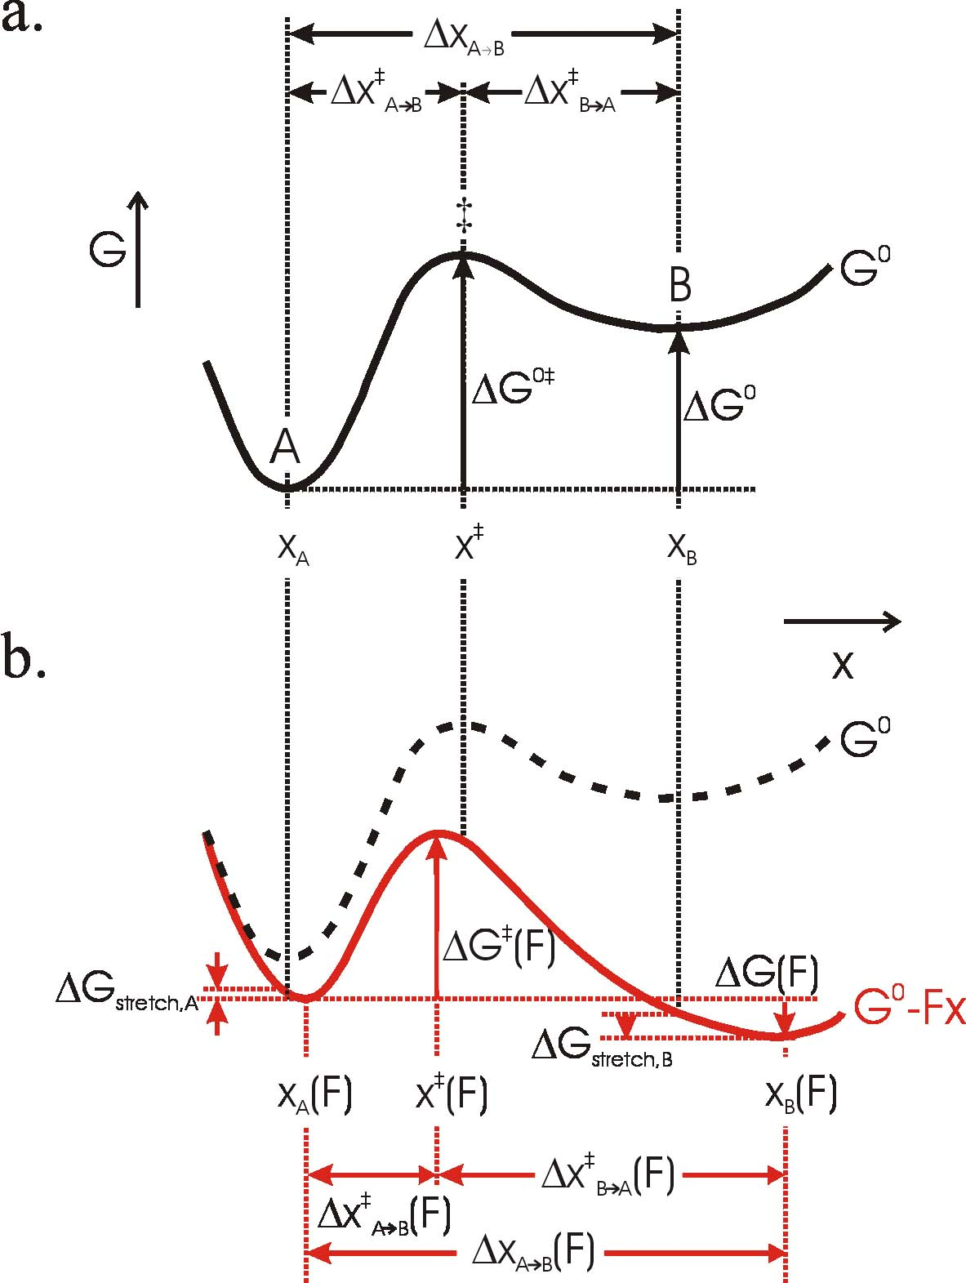

Slide 25
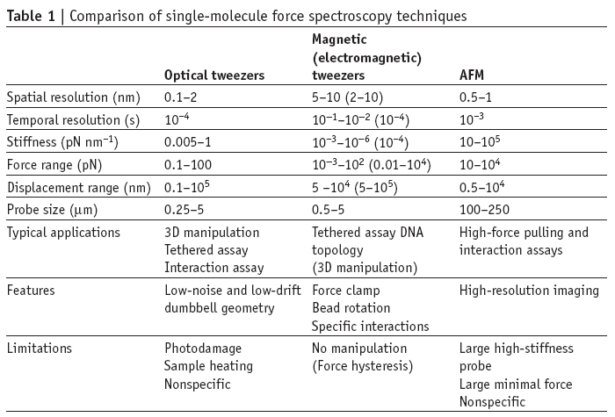
Nature Methods (2008) 5:491

Slide 26
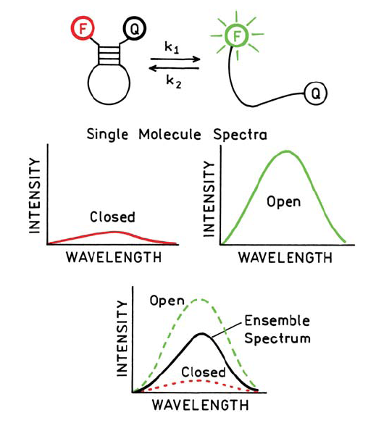
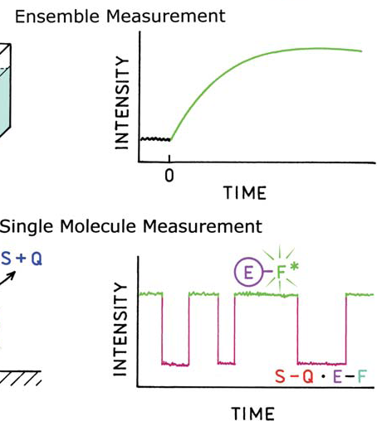
Fluorescencia a nivel de moléculas individuales
Lakowicz, 2003

Slide 27
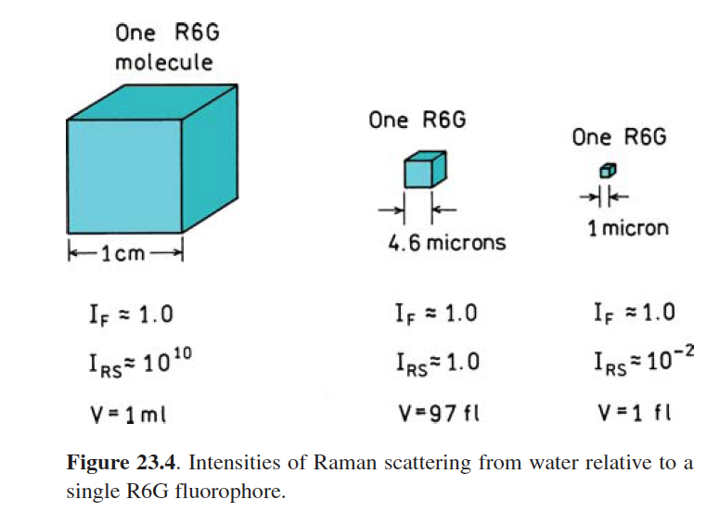
Fluorescencia a nivel de moléculas individuales
Lakowicz, 2003

Slide 28
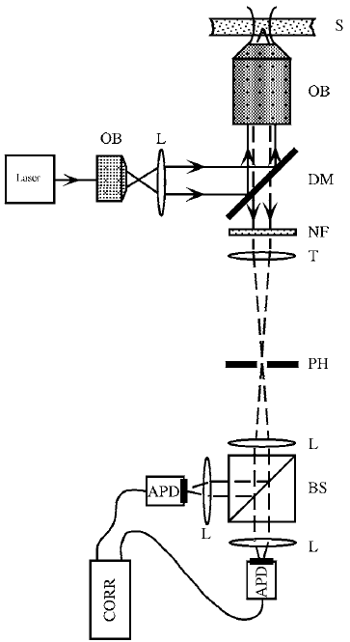
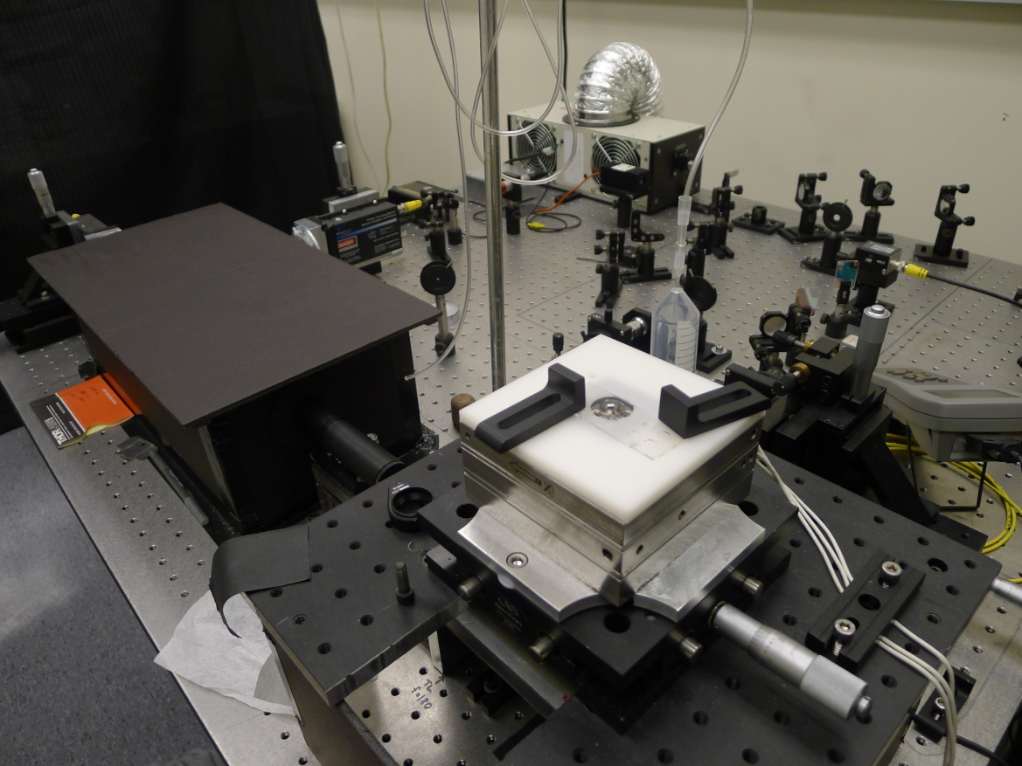
Instrumento de FCCS
Fluorescence cross-correlation spectroscopy
S: sample; OB: objective; L: lens; DM: dichroic mirror
NF: notch filter; T: tube lens; PH: pinhole; BS: beamsplitter;
APD: avalanche photodiode; CORR: correlator (ALV-5000/EPP)
Rep. Prog. Phys. 65 251

Slide 29
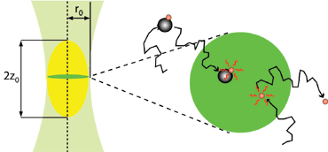
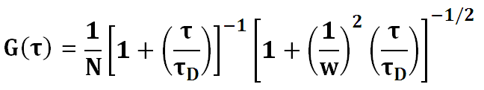
Análisis de datos
Sampling and lag time: 200 ns
ALV-5000/EPP
Correlator
N: Dyes in the confocal volume
w: Structure factor
τ_{D} : Diffusion time

Slide 30
FCS measurement: Catalase
[H₂O₂]:
Yellow: 0 mM, Green: 3 mM,
Red: 6 mM,
Blue: 12 mM, Black: 25 mM

Slide 31
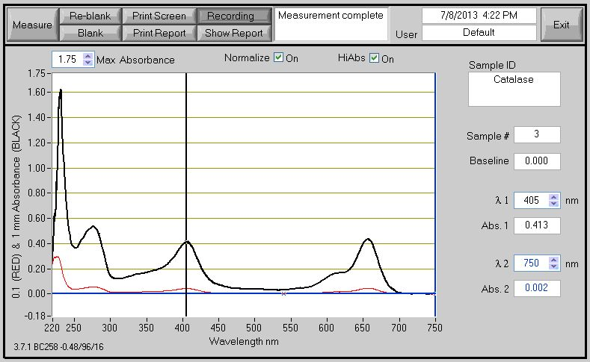
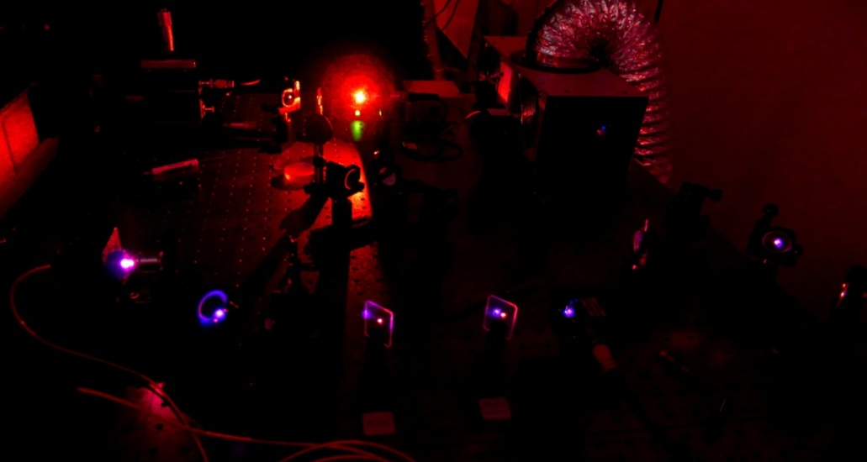
Heat released by the heme (402 nm)
Absortion spectra
Catalase
Free dyes

Slide 32
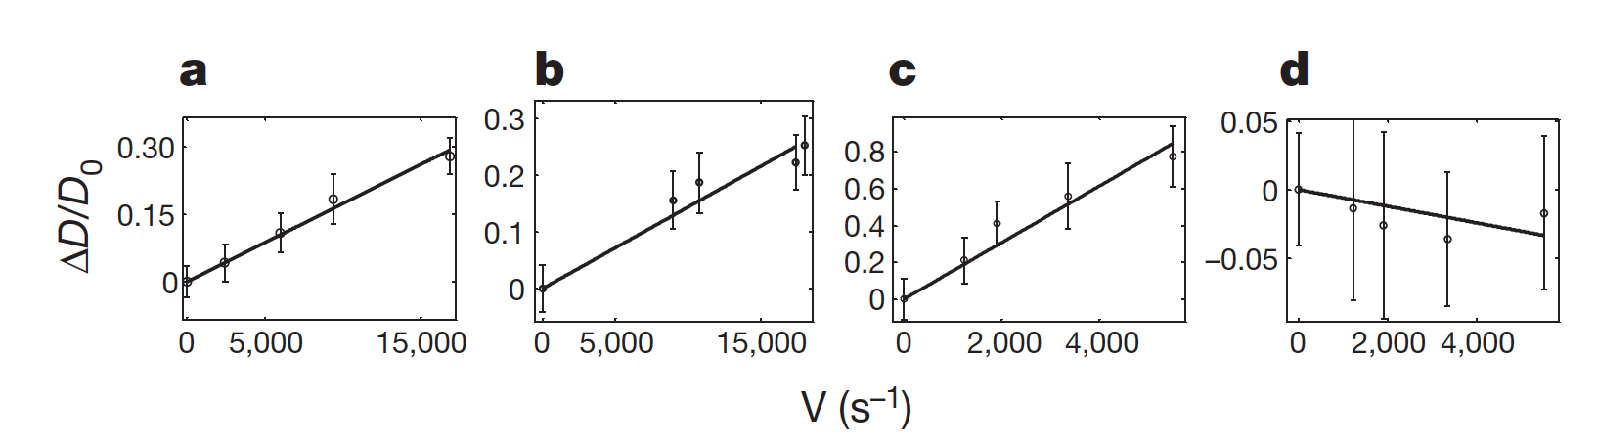
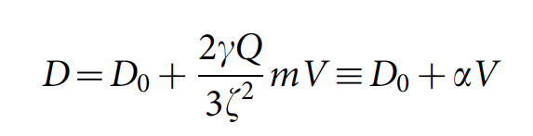
Enhanced diffusion as a function of the reaction rate
(a) catalase, (b) urease, (c) and alkaline phosphatase, (d) triose phosphate isomerase

Slide 33
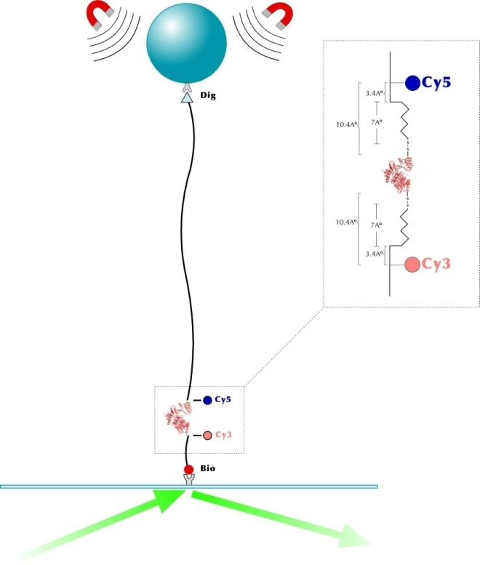
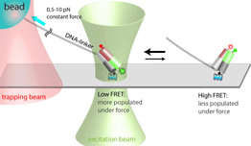
Instrumentos combinados
Optical tweezers and Fluorescence
http://bio.physics.illinois.edu/
Magnetic tweezers and TIRF

Slide 35
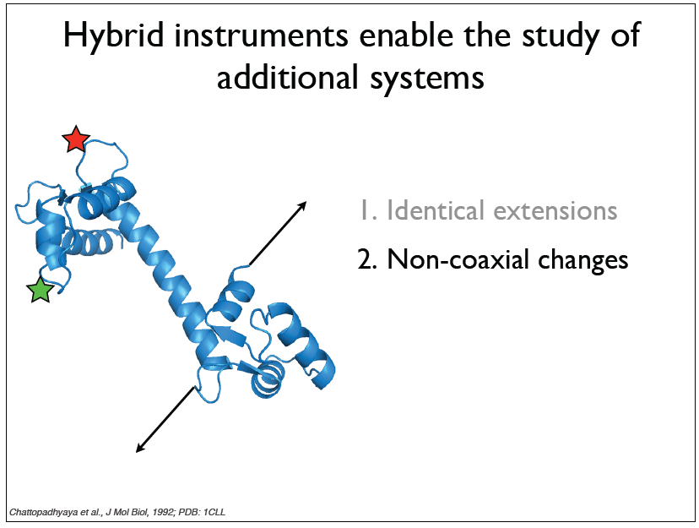

Slide 36
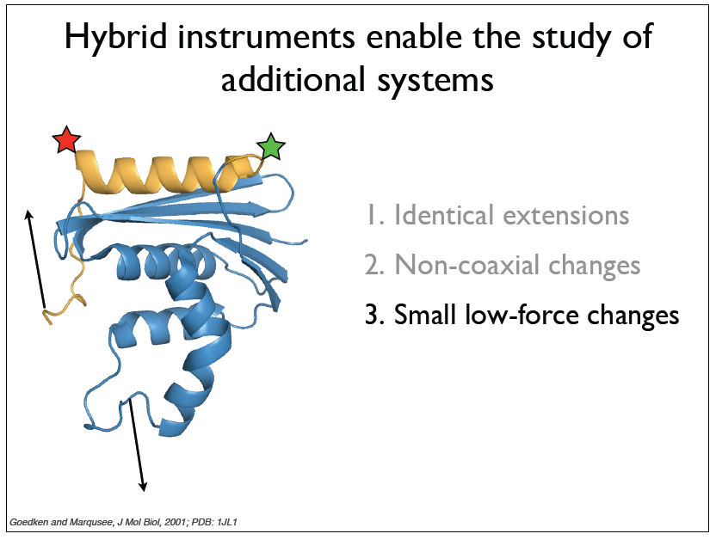

Slide 37

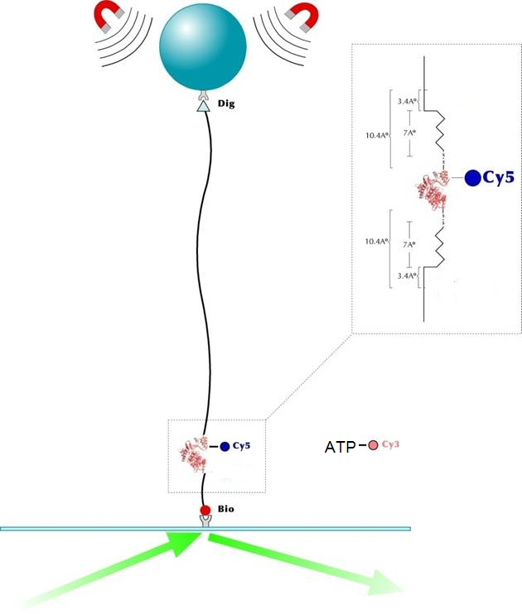
Setup of magnetic tweezers and TIRF
TIRF microscopy and Magnetic tweezers
37
Notes:
Here is the setup that we will use to test the effect of force on catalysis
37

