Slide 1
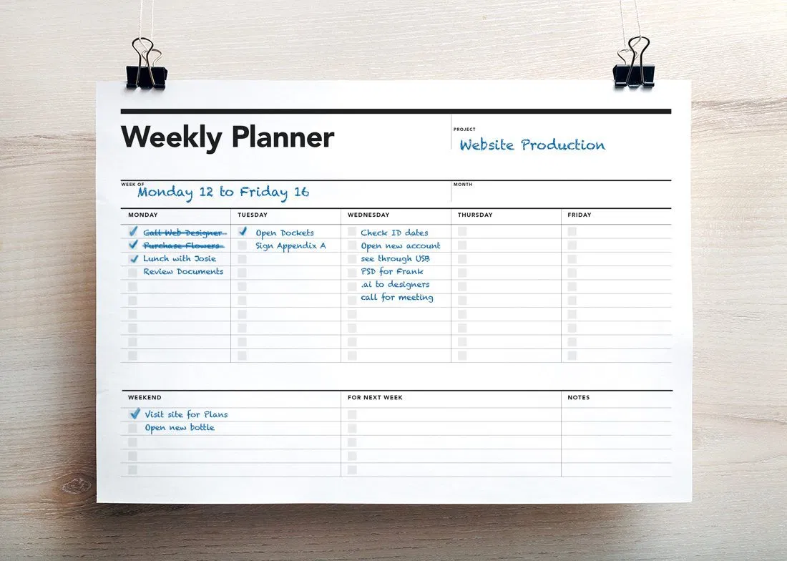
3B
LET´S MEET AGAIN

Slide 2

THE FUUUUTURE
GOING TO
PLANS
PREDICTIONS (+EVIDENCE)
?
?

Slide 3
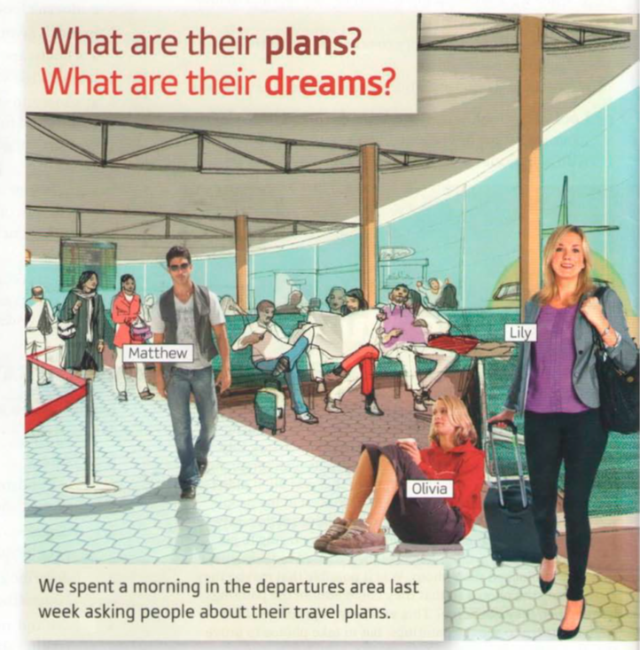
Do you remember Lily from the previous unit?

Slide 4
Why does Lily get in touch with Ben?
What are they planning to do?

Slide 5

Let´s listen

Slide 6
LET´S LISTEN AGAIN
I´m flying from Boston on JetBlue
I´m arriving in San Francisco at 2:40 p.m.
I´m staying at a hotel near the convention center
What tense is this?
PRESENT CONTINUOUS
Are these sentences referring to Present, right here, right now?
NO

Slide 7
We can use the PRESENT CONTINUOUS for situations happening right here, right now:
I am listening to Carol´s explanation at the moment.
We can use the PRESENT CONTINOUS for plans we make at a fixed time and place .
(Your agenda)
Carol is having lunch with Jason next Tuesday

Slide 9
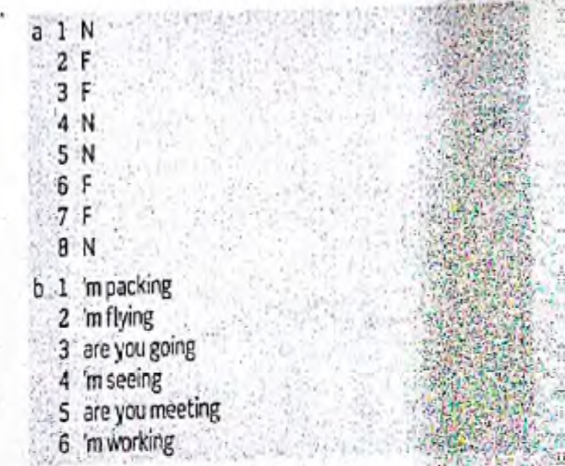

Slide 11
LET´S SPEAK

