Slide 1
Unit 2A

Slide 3
VOCABULARY

Slide 4
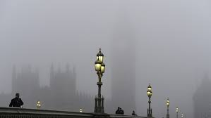
VOCABULARY

Slide 5
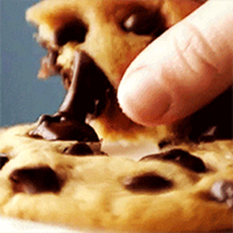
LET´S PLAY
Think of a city/town you have visited and describe it using the vocabulary from the Unit.
Do not mention the name of the place
Let your classmates guess
The winner gets a Golden cookie

Slide 6
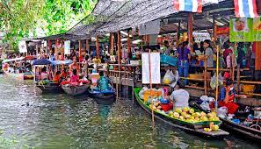
TO FLIRT To behave as though sexually attracted to someone, but playfully rather than with serious intentions.
TO BREAK UP: If a marriage breaks up or two people in a romantic relationship break up, their marriage or their relationship ends

Slide 7


CHEAP: Not generous
TO COMPLAIN: to say that something is wrong or not satisfactory

Slide 8
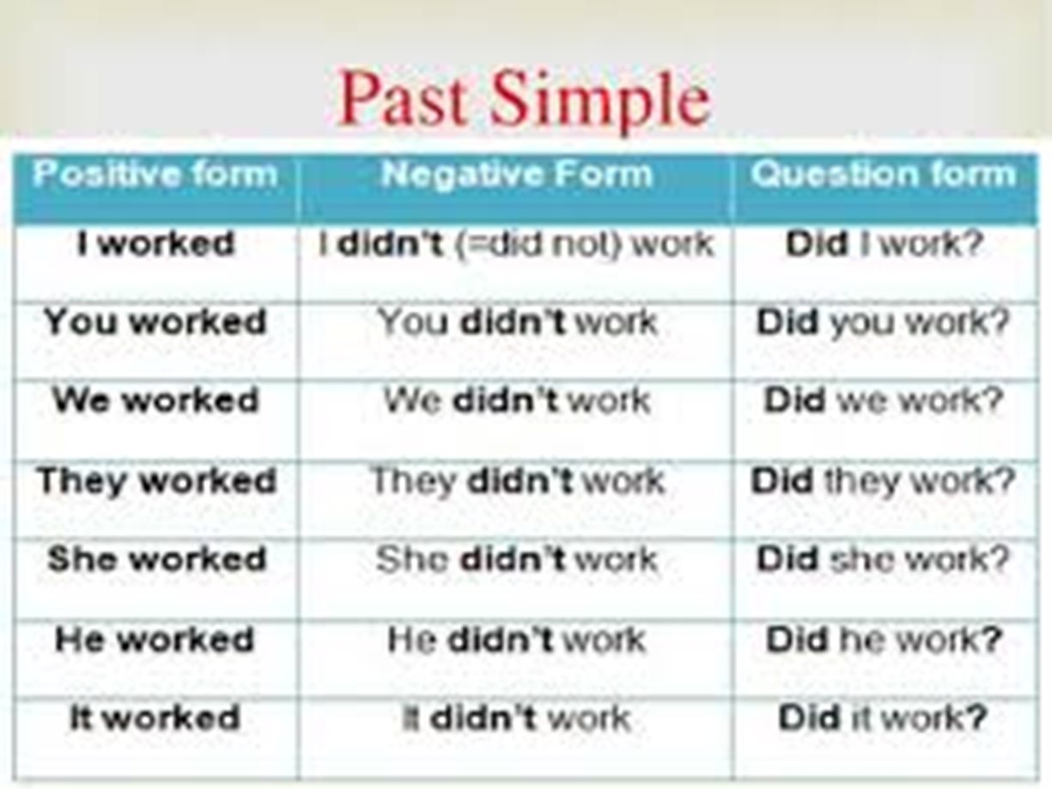

Slide 9
LET´S PRACTICE

Slide 10
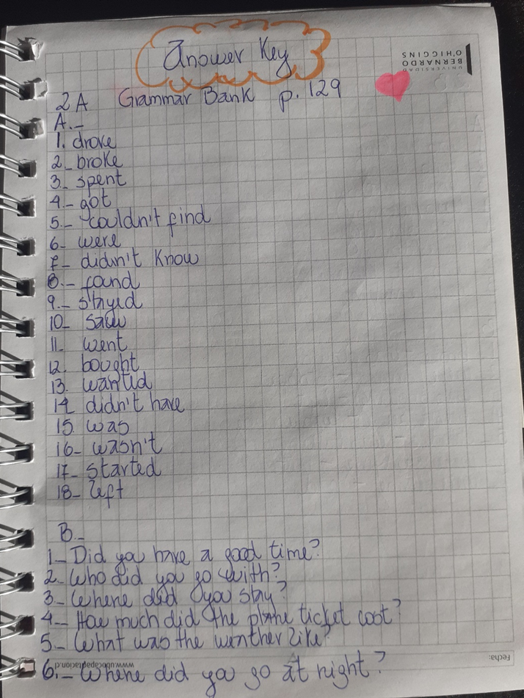

Slide 11
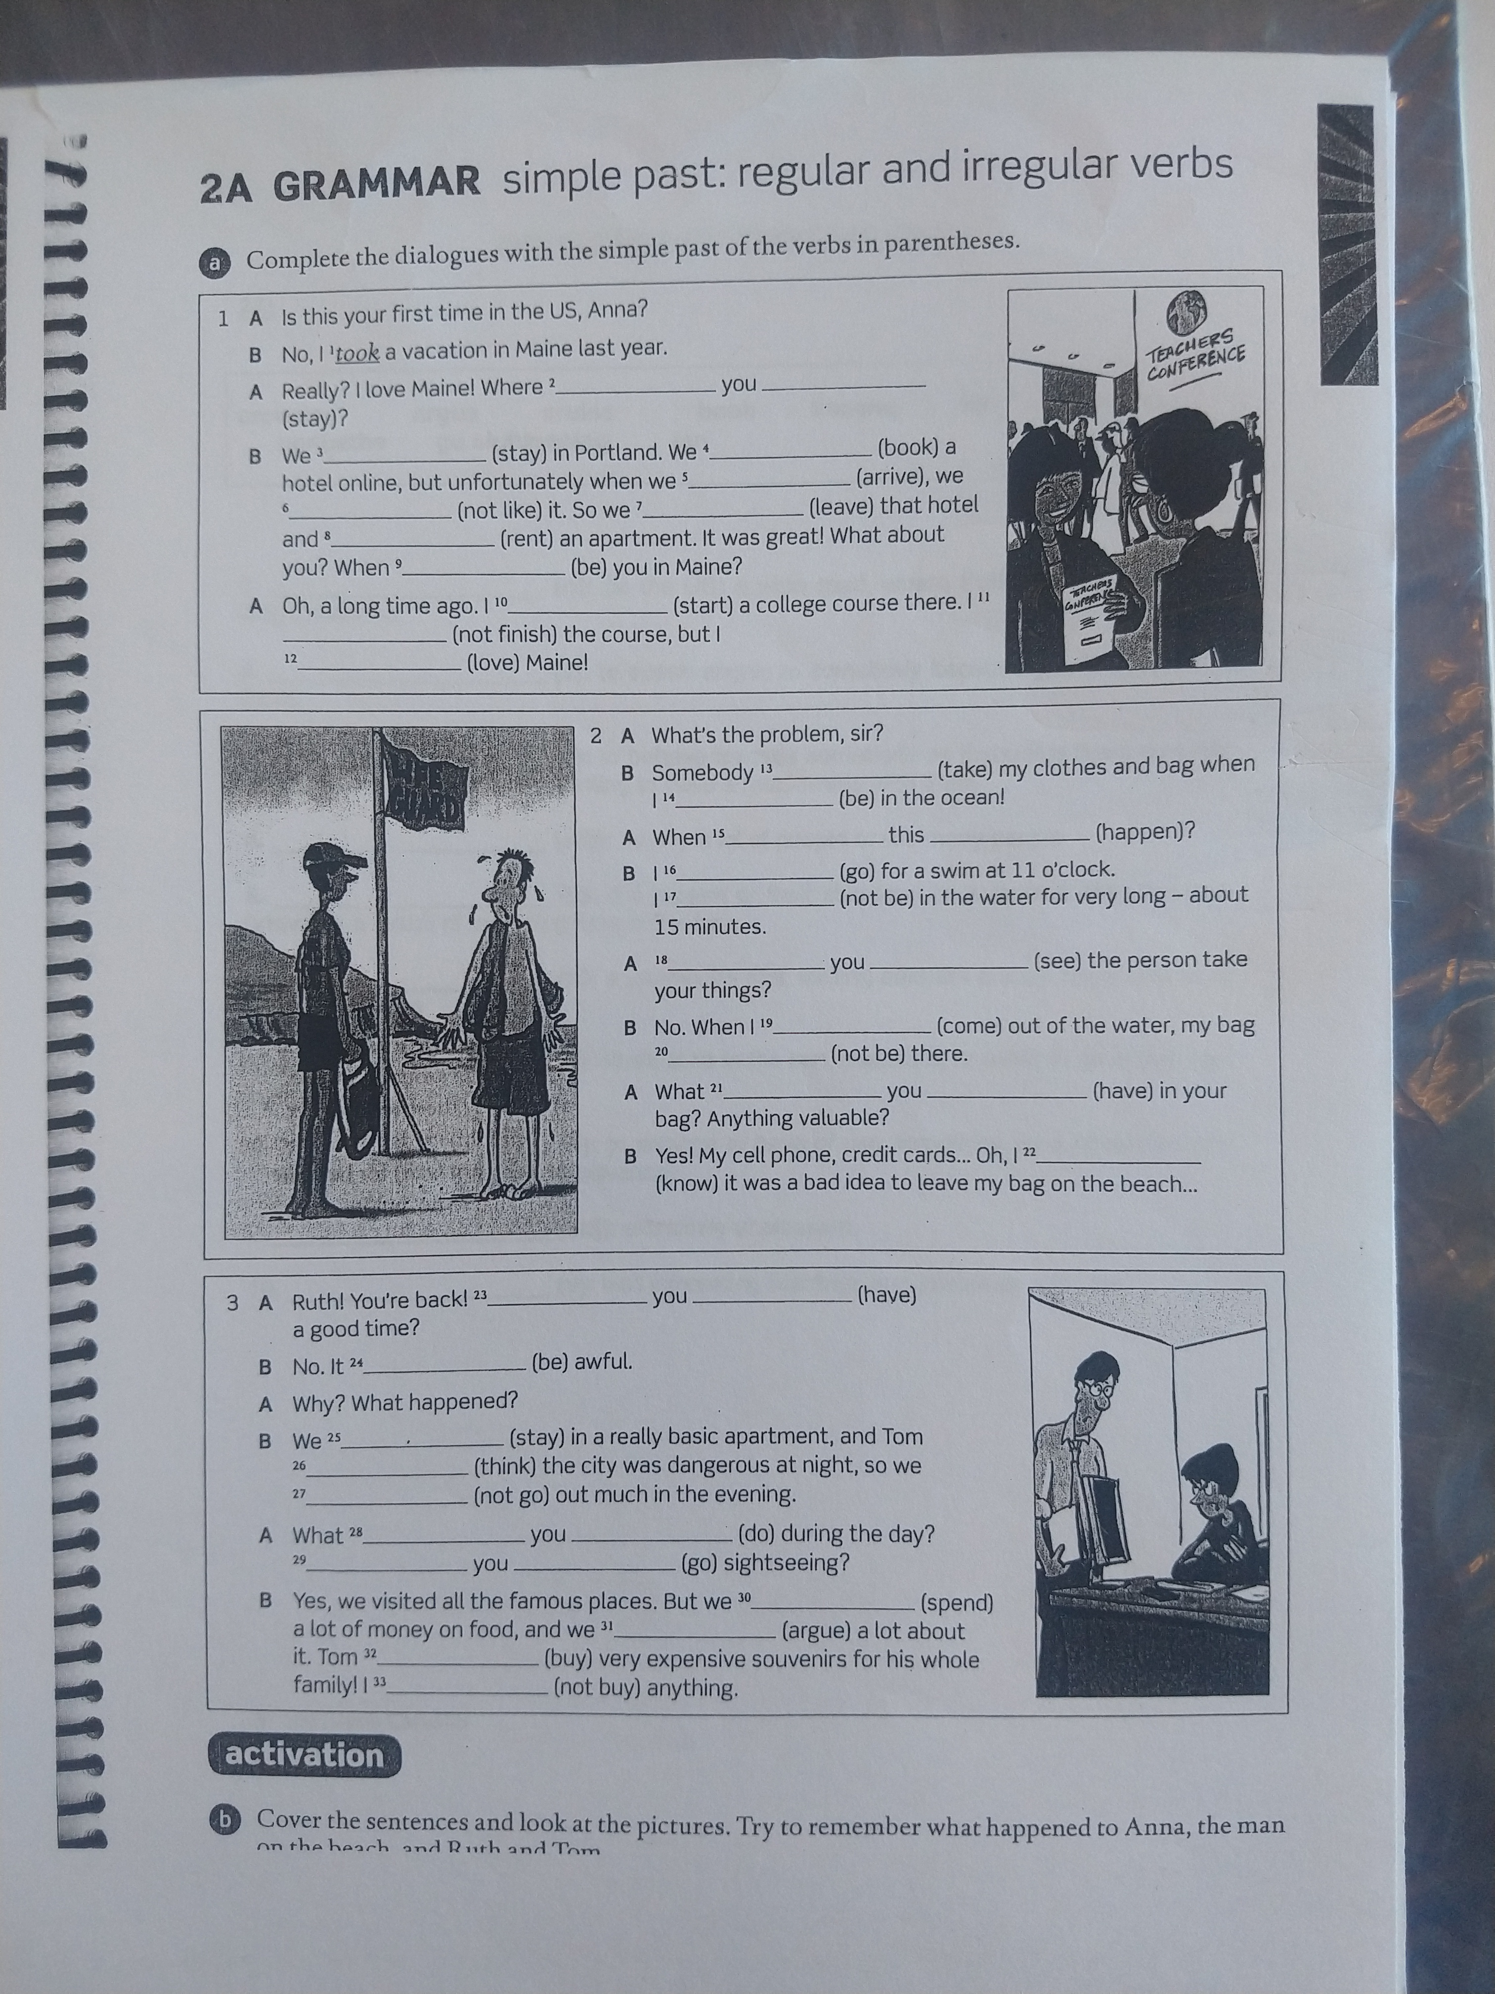
HOMEWORK

Slide 12
SPEAKING
Get a partner and talk!

