Slide 1
UNIT 1 A

Slide 3

Questions in English follow a VERY STRICT Order!
VERY STRICT ORDER
VERY STRICT

Slide 4
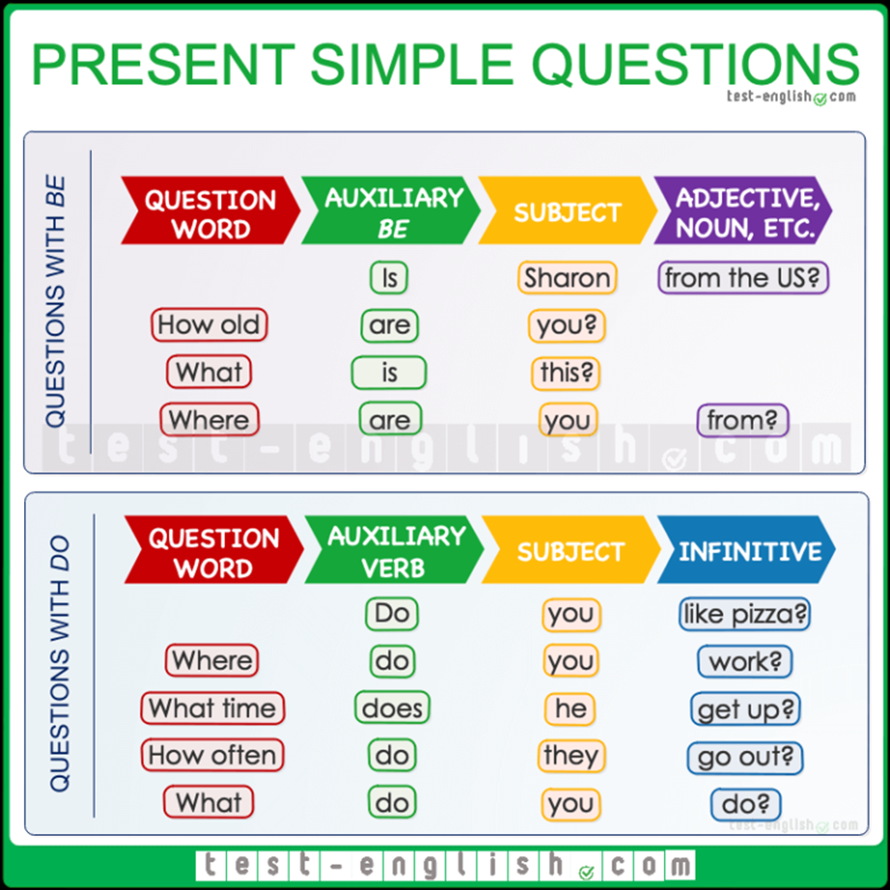

Slide 5
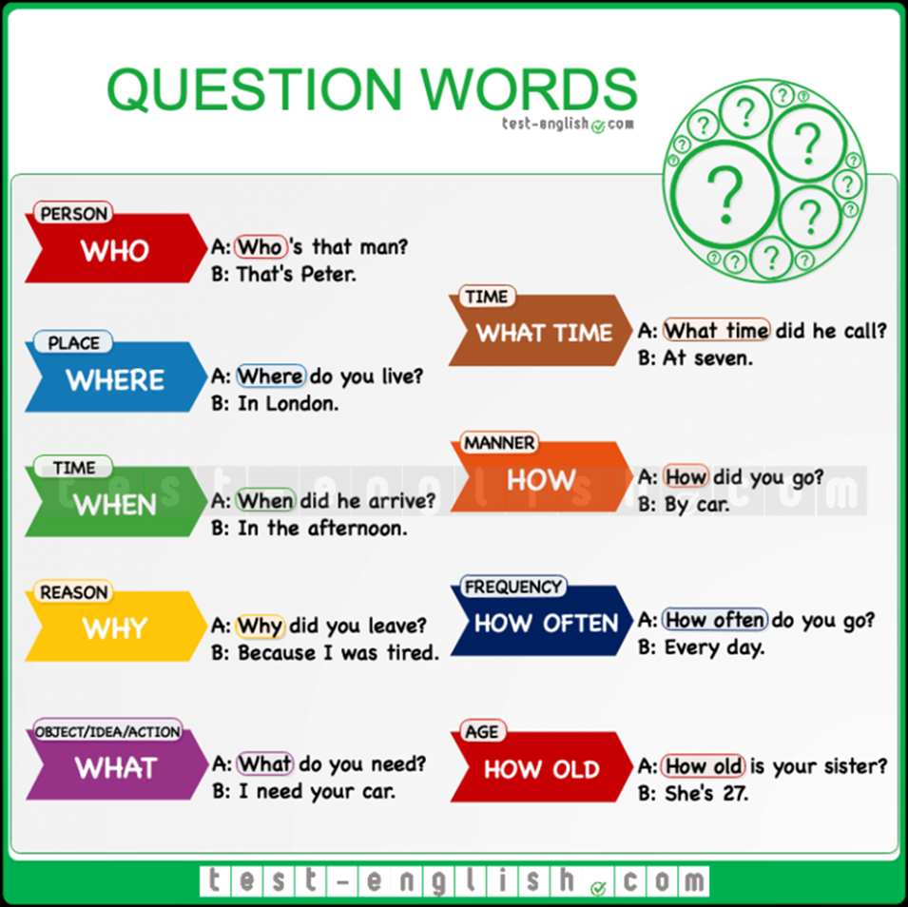

Slide 6
LET´S
PRACTICE

Slide 7
LET´S PRACTICE

Slide 8
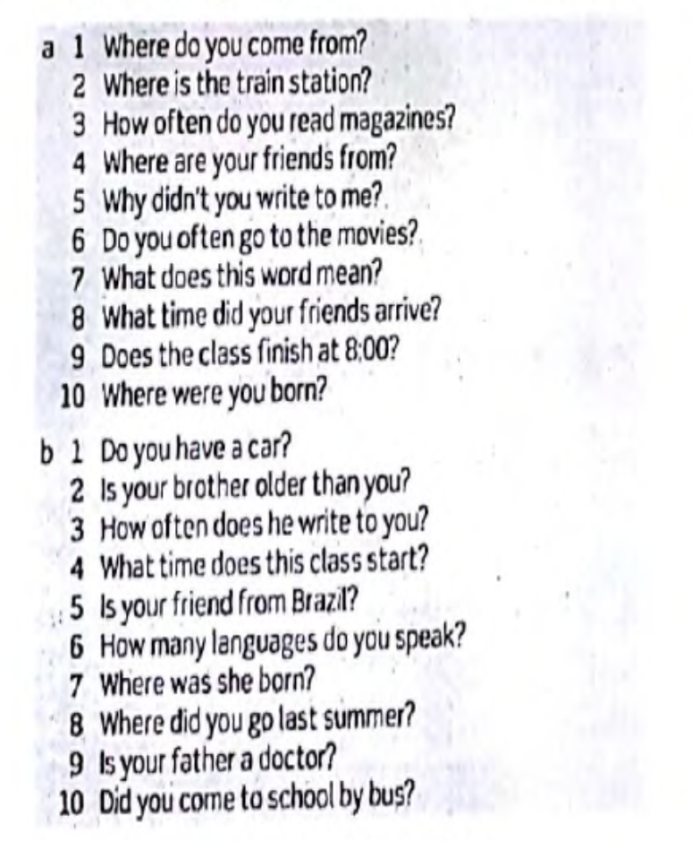
LET´S PRACTICE

Slide 9
HOMEWORK

Slide 10
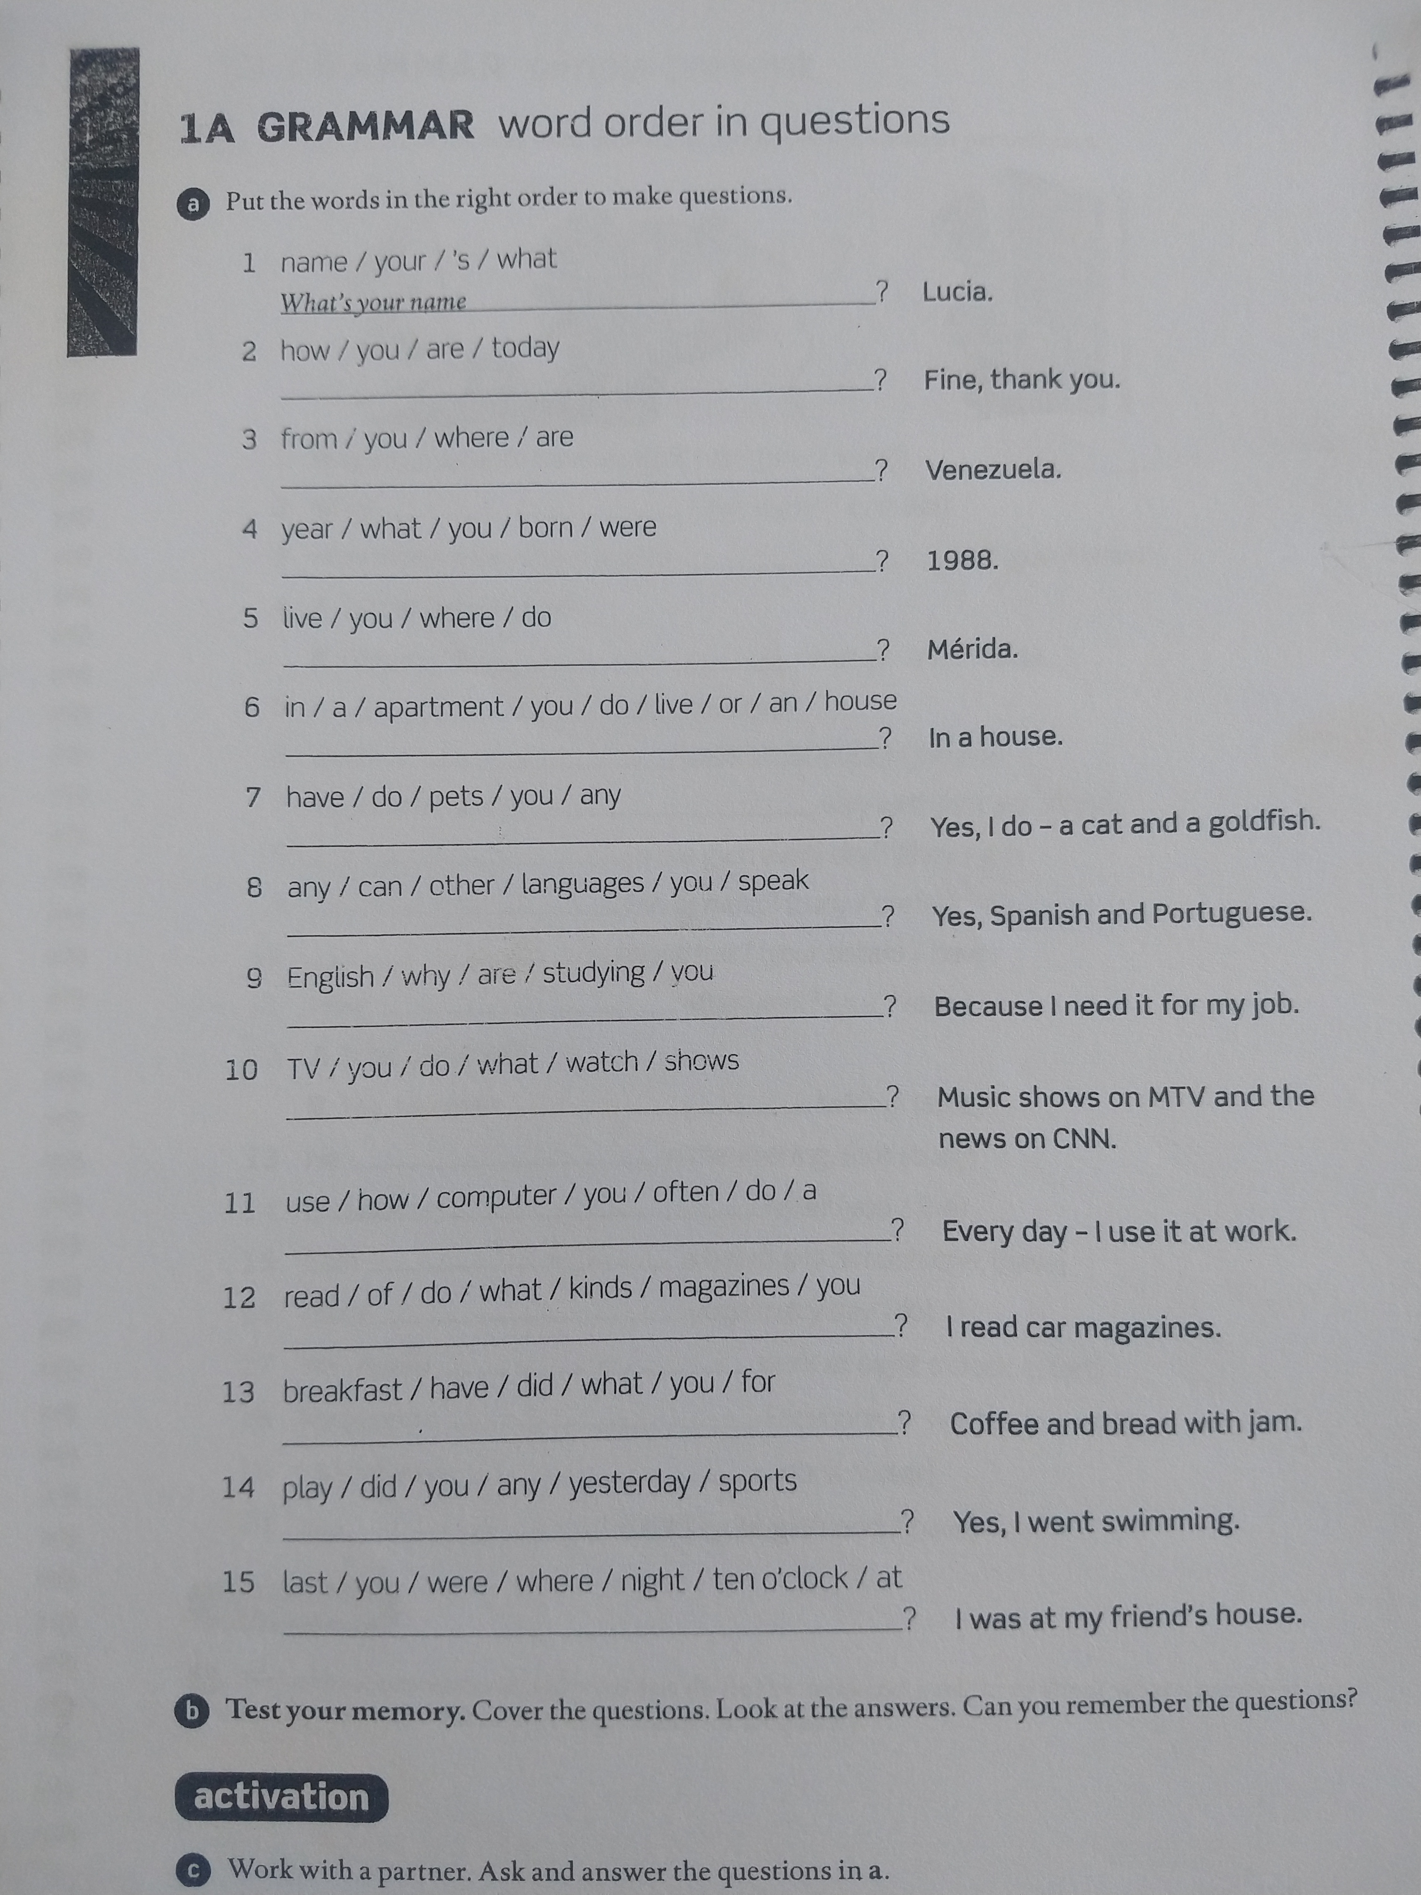

Slide 11
ADDITIONAL EXERCISE

Slide 12
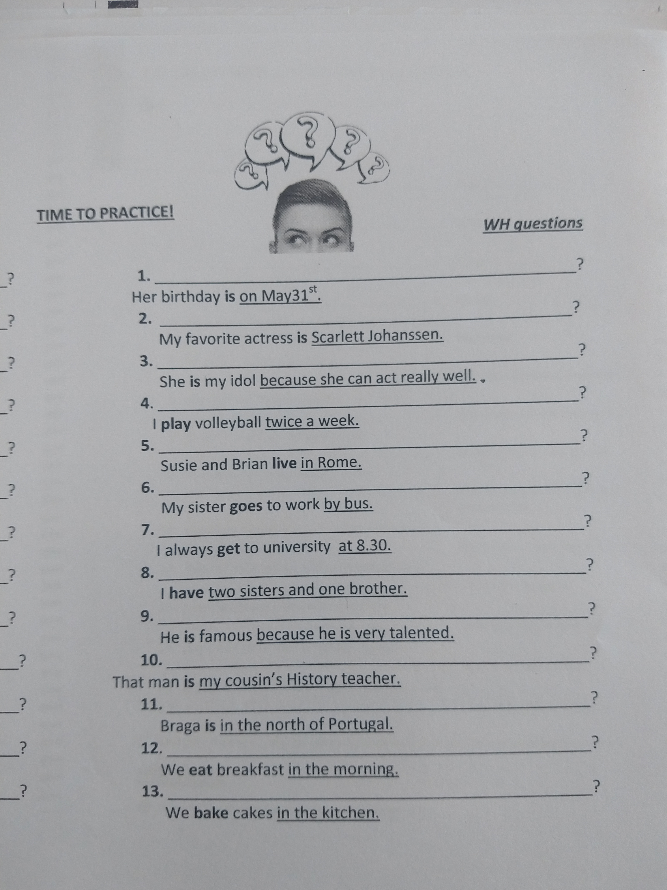
ANSWER KEY
When is her birthday?
Who is your favorite actress?
Why is she your idol?
How often do you play voleyball?
Where do they live?
How does your sister go to work?
What time do you get to university?
How many sisters and brothers do you have?
Why is he famous?
Who is that man?
Where is Braga?
What time do we eat breakfast?
Where do we bake cakes?

