Slide 1
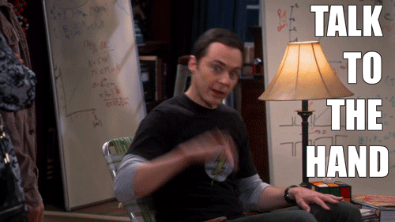
Arguments
By Carol

Slide 2
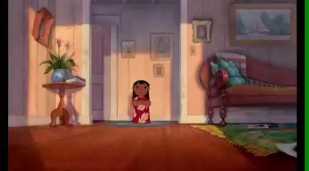

Slide 3
Carol loves watching animated movies and anime.
She must have free time to watch the movies
She may/might watch the movies when preparing material for her classes
She can´t watch the movies when teaching her class
Possible
Impossible
Modal verb + Base form

Slide 4
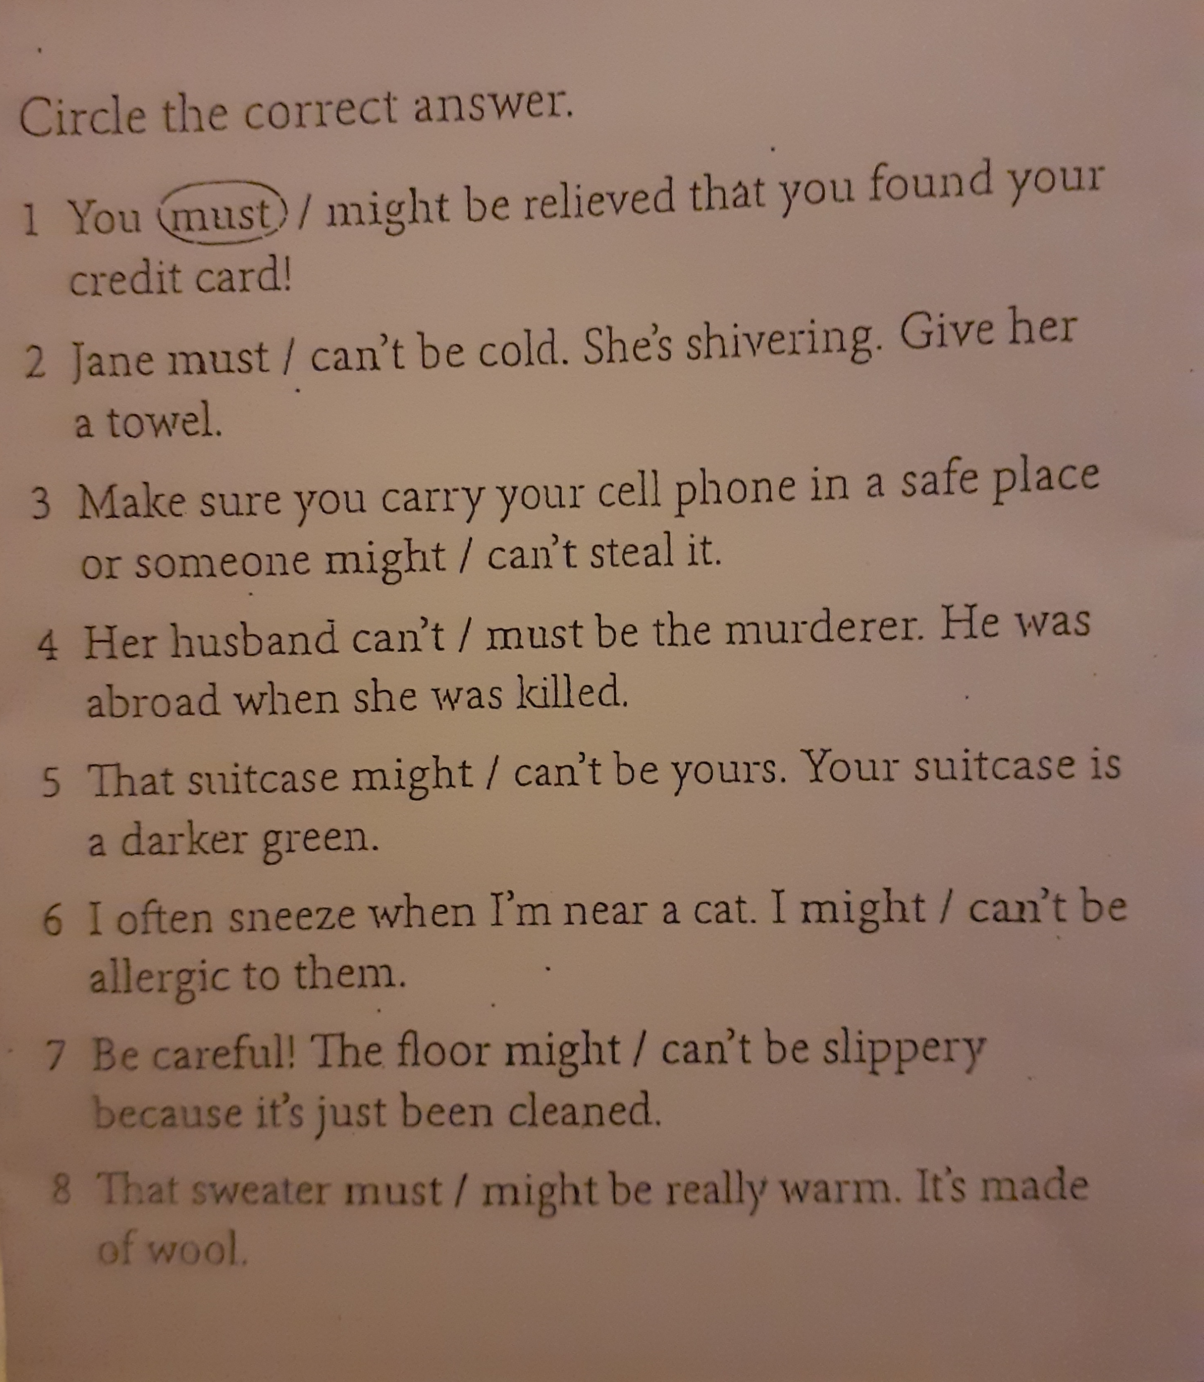
Let´s practice!

Slide 5

Carol didn´t watch any animated movie last weekend.
She must have been very busy doing other things.
She may/might not have had any computer available
She couldn´t have had free time.
Possible
Impossible
Modal verb + have +Participle

Slide 6

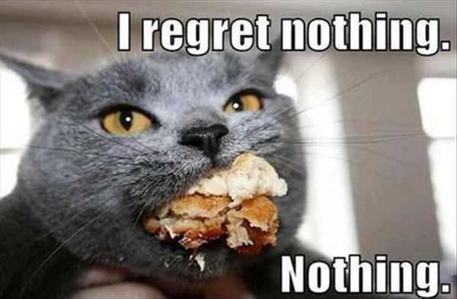
Carol felt sad because she couldn´t watch any animated movie last weekend.
She should have worked harder during the week.
Should + have +Participle

Slide 7

ARGUMENTS

Slide 8
LET´S PRACTICE

Slide 9
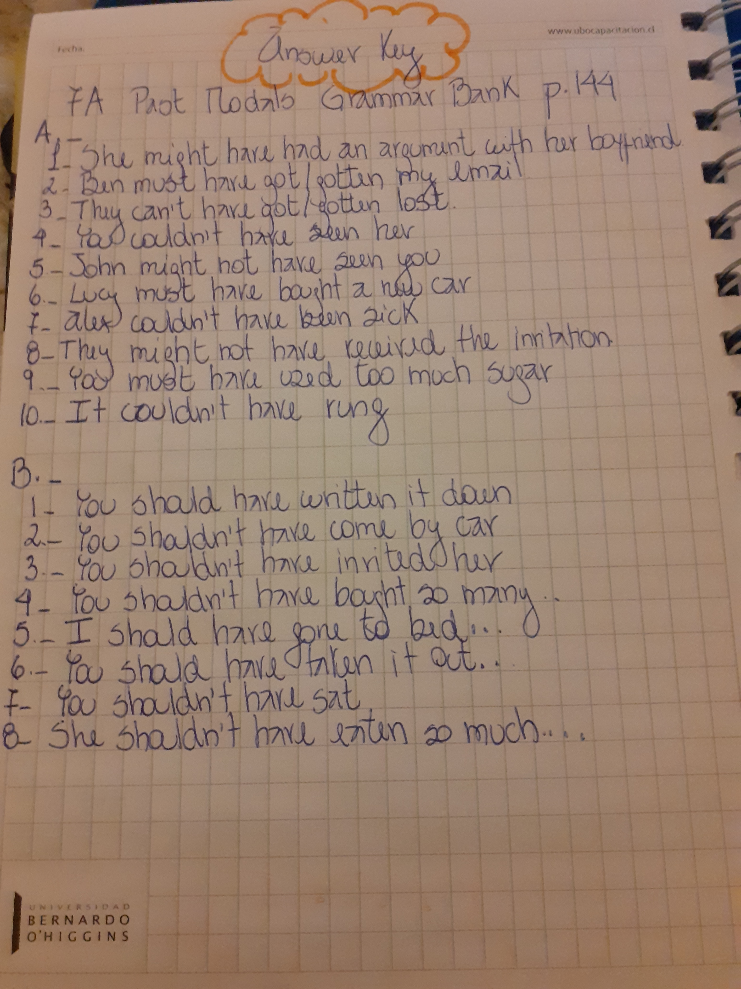

Slide 10
LISTENING
Group discusión
What are the best tips?Why?
What are the worst tips?Why?

Slide 11
LISTENING

Slide 12
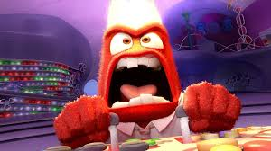
To keep things under control

Slide 13
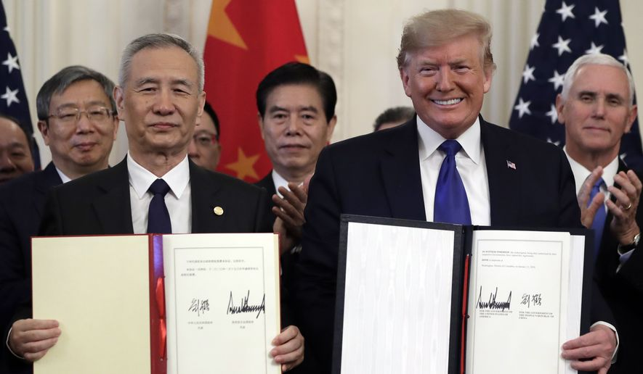
To reach an agreement

Slide 14
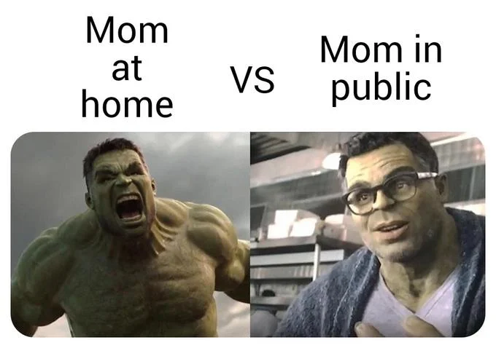
To lose sb’s temper

Slide 15
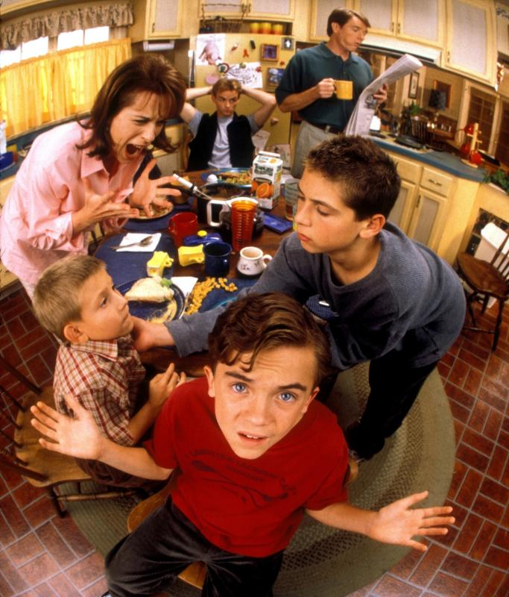
To deal with conflict

Slide 16
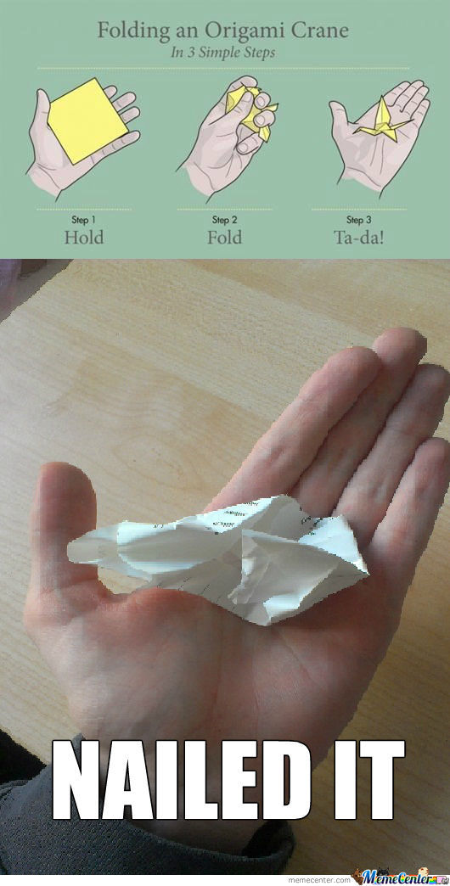
To be easier said than done

Slide 17
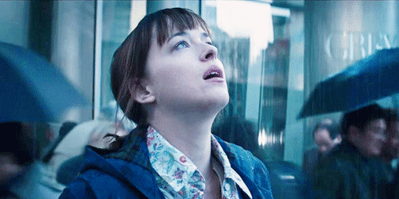
To take a deep breath

Slide 18
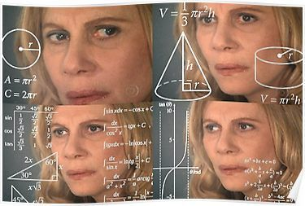
Confusing verbs

Slide 21
Avoid/Prevent
Avoid
Miss. If you avoid something you miss it, or try to make it miss you. You can avoid something or avoid something happening.
Prevent
I avoided the slap easily.
I avoided being discovered by hiding.
His hand prevented the cup falling.
Preventing something means stopping it, often before it has happened.
The arrival of the police prevented crime.

Slide 22
Wait/Expect
Wait
We use wait when we refer to letting time pass because we are expecting that something is going to happen.
Expect
We use expect to say that we believe that something will happen.
Don’t worry. I’ll wait for you.
We expect to move into our new flat next week.

Slide 23
Hope/Wish
Hope
We use hope when we do not know whether something will happen or not but we want it to happen.
Wish
We use wish when we regret or are sorry that things are not different. We imagine a different past or present:
I think you were hoping to see your family next week.
I wish I had his mobile phone number; we could tell him the good news.

Slide 24
They expect to pass the exam
They hope to pass the exam
They wish they could pass the exam

Slide 25
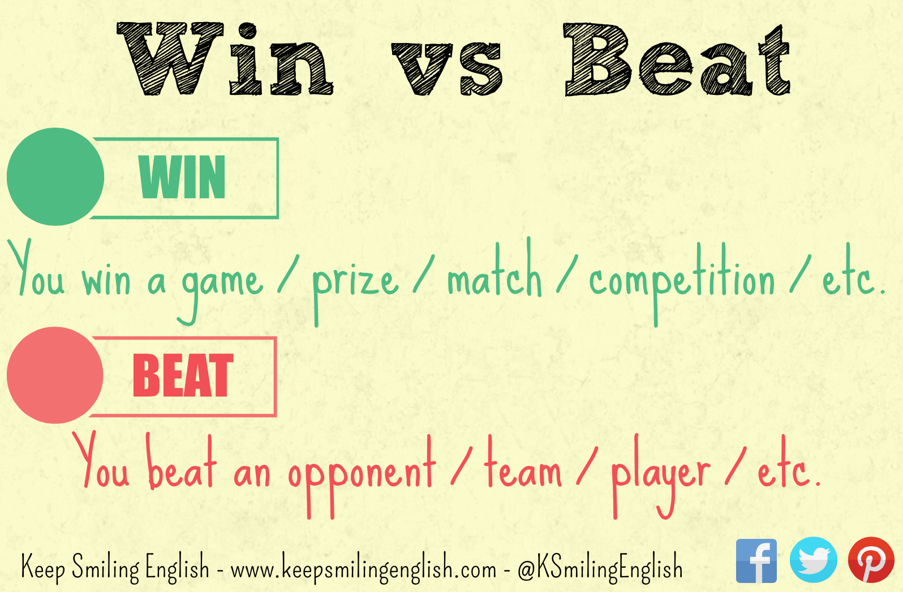
Win /Won/Won
Beat/Beat /Beaten

Slide 26
Mind/Matter
Mind
It means 'dislike, be annoyed by or object to'. If someone says I don't mind, it means that they have no preference or that they are happy for something to happen.
Matter
The verb matter can mean 'be important'. If we say 'it doesn't matter', it means that the thing that we are talking about is not important or not significant.
I don't mind having tea or coffee.
Does he mind you arriving a little late?
It doesn't matter what we have for dinner.
It doesn't matter where you go. I will always be with you.

Slide 27
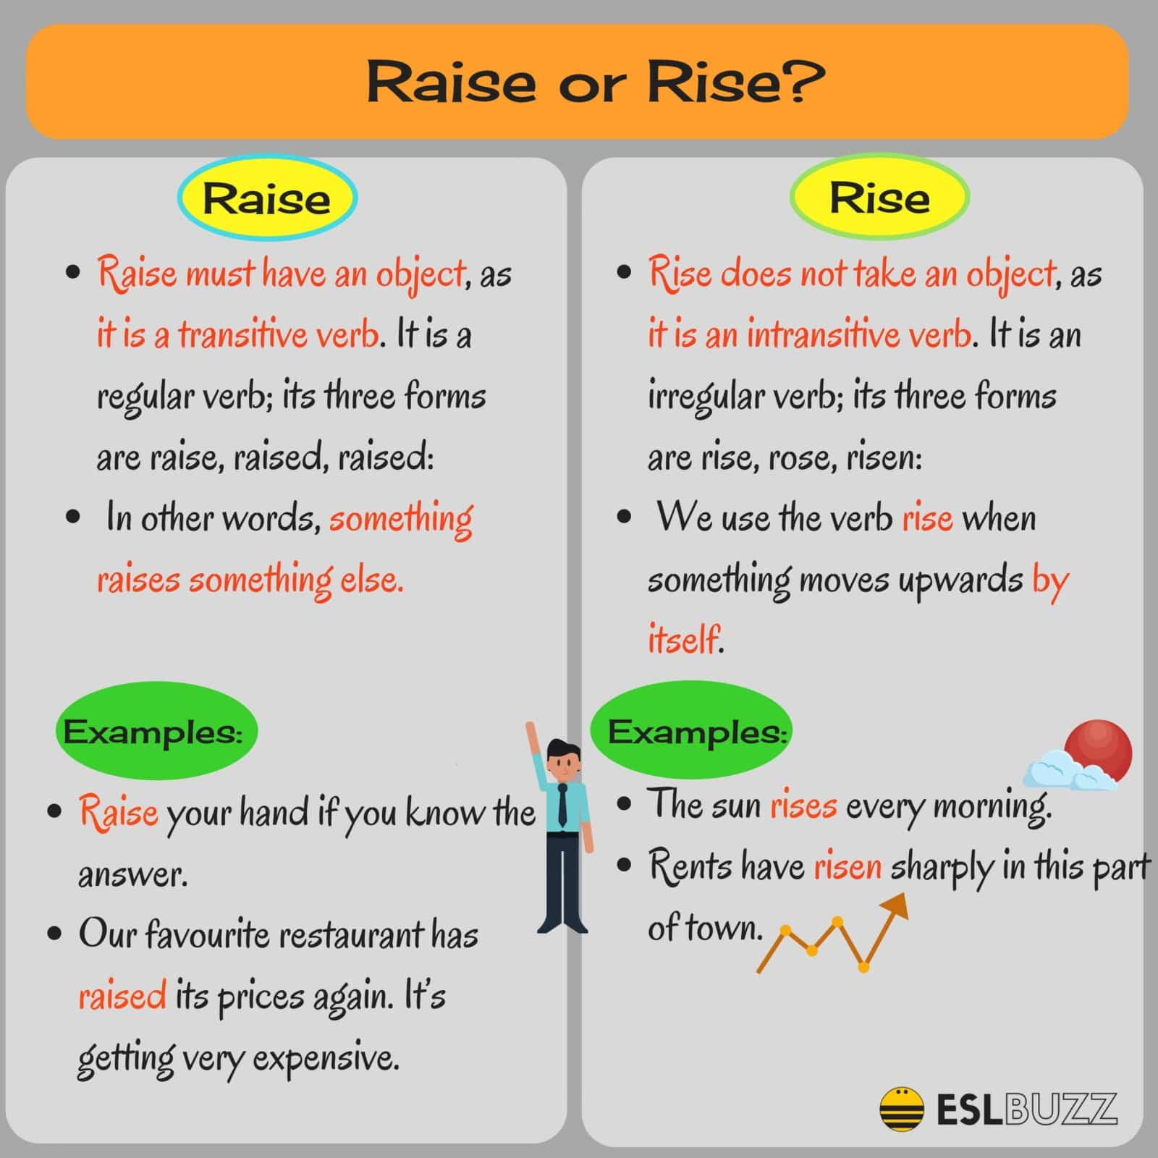

Slide 28


Raise /Rise

Slide 29
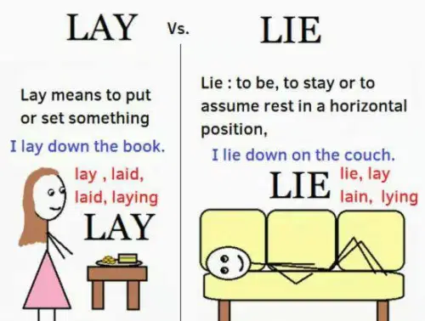
Lay/Lie

Slide 30
LET´S PRACTICE

Slide 31
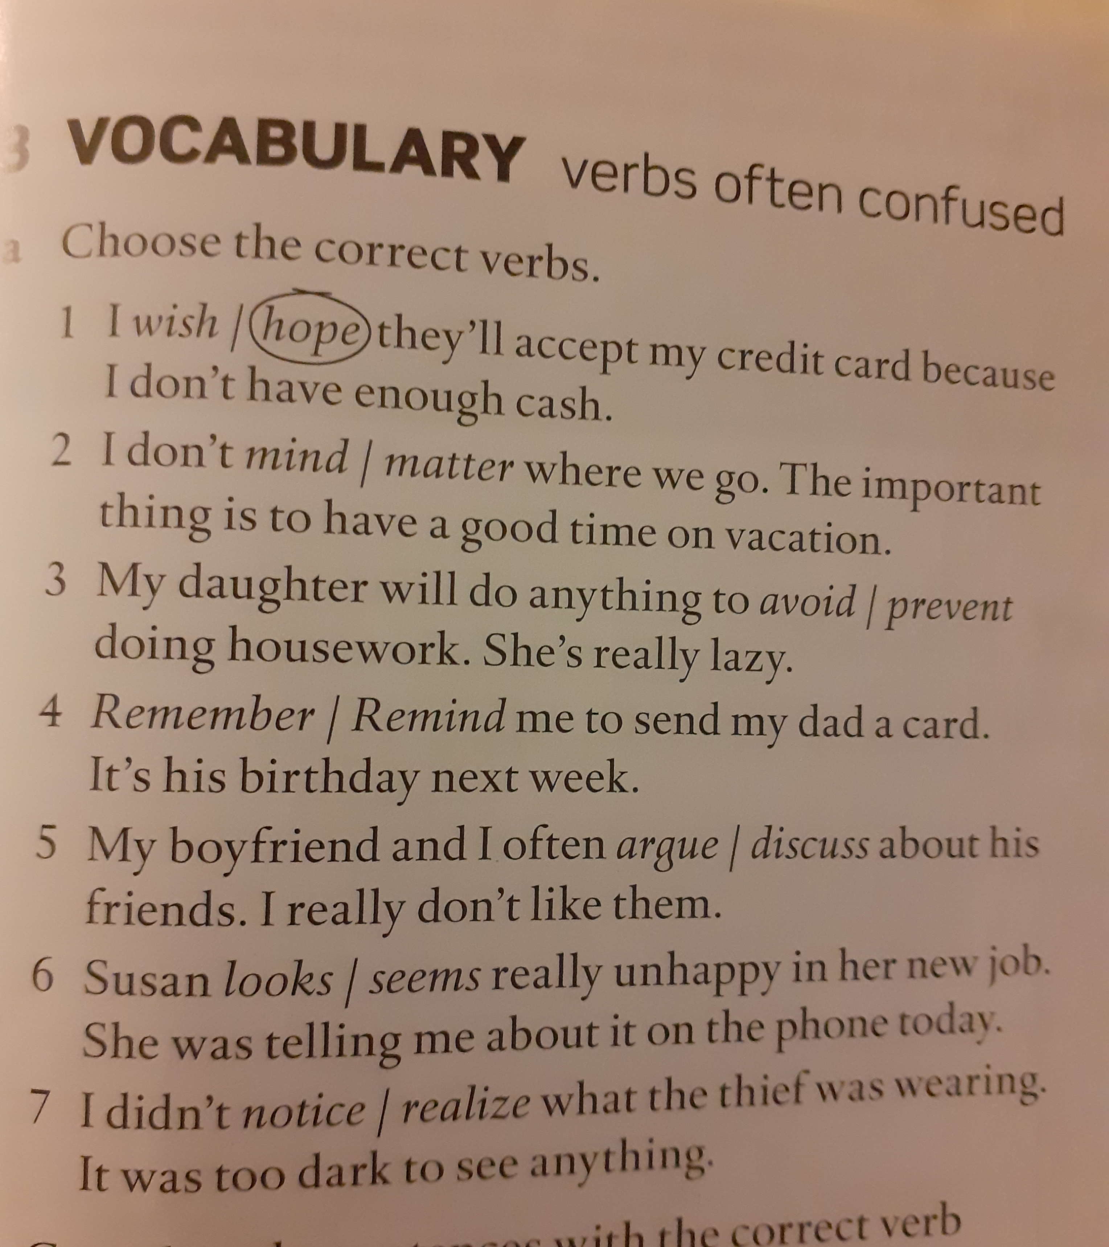
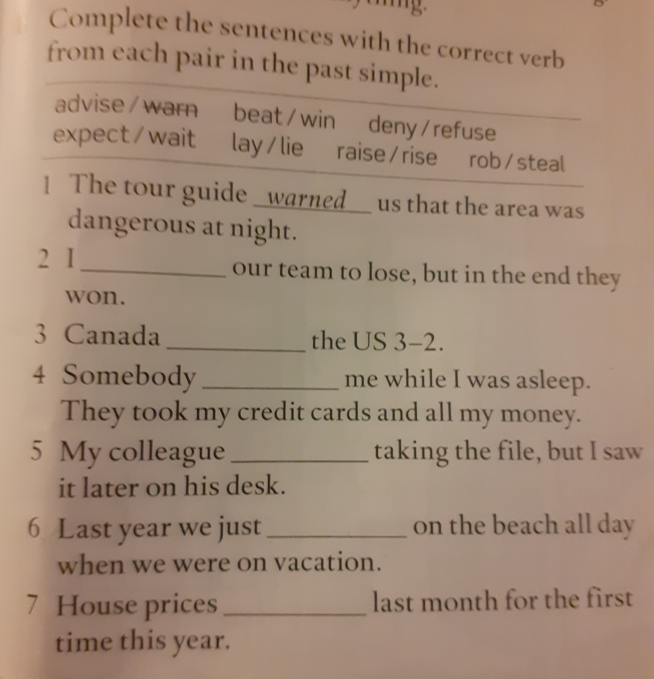
LET´S PRACTICE

Slide 32
REFERENCES
https://www.bbc.co.uk/learningenglish/course/eiam/unit-1/session-30
https://keepsmilingenglish.com/2015/05/confusing-verbs-9-win-vs-beat/
https://www.bbc.co.uk/learningenglish/course/eiam/unit-1/session-43
https://www.eslbuzz.com/confusing-words-raise-vs-rise-job-vs-work/
http://editing.xterraweb.com/writing-tips/lay-vs-lie
https://safenglish.wordpress.com/2017/09/26/lay-vs-lie/

