Slide 1
Sleep is your super power
By Carol

Slide 2

Speaking
Do you like sleeping?
How much do you sleep?
How has the pandemic affected your sleep time/quality?

Slide 3

listening

Slide 4
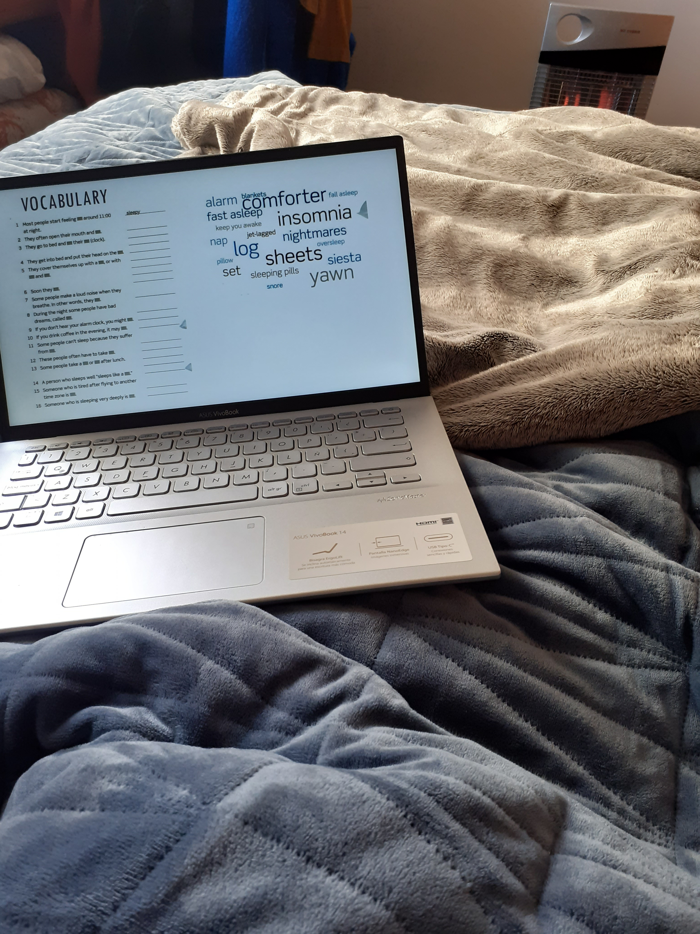
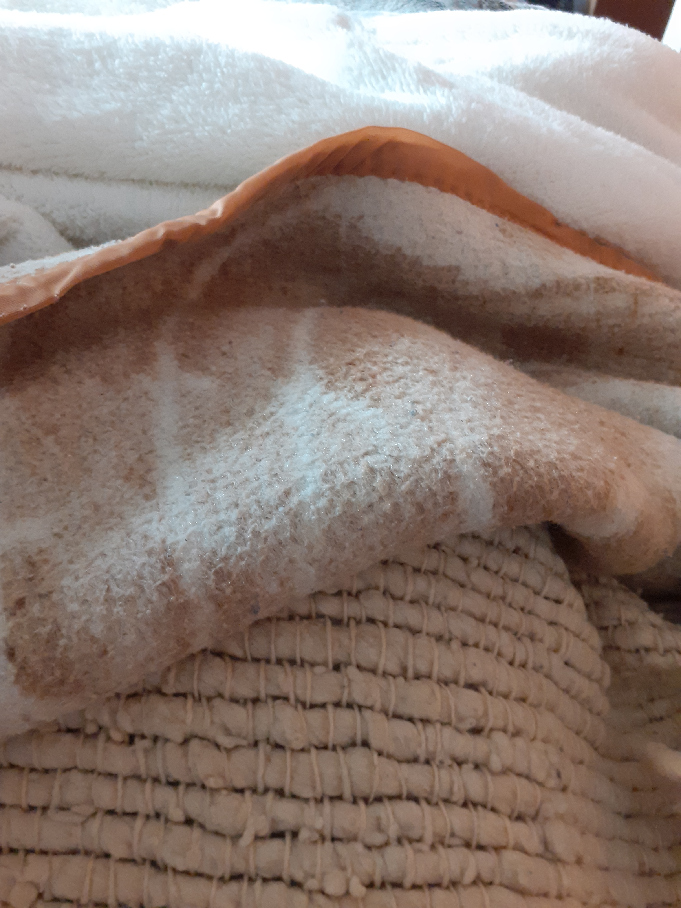

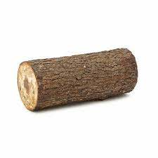
vocabulary

Slide 5
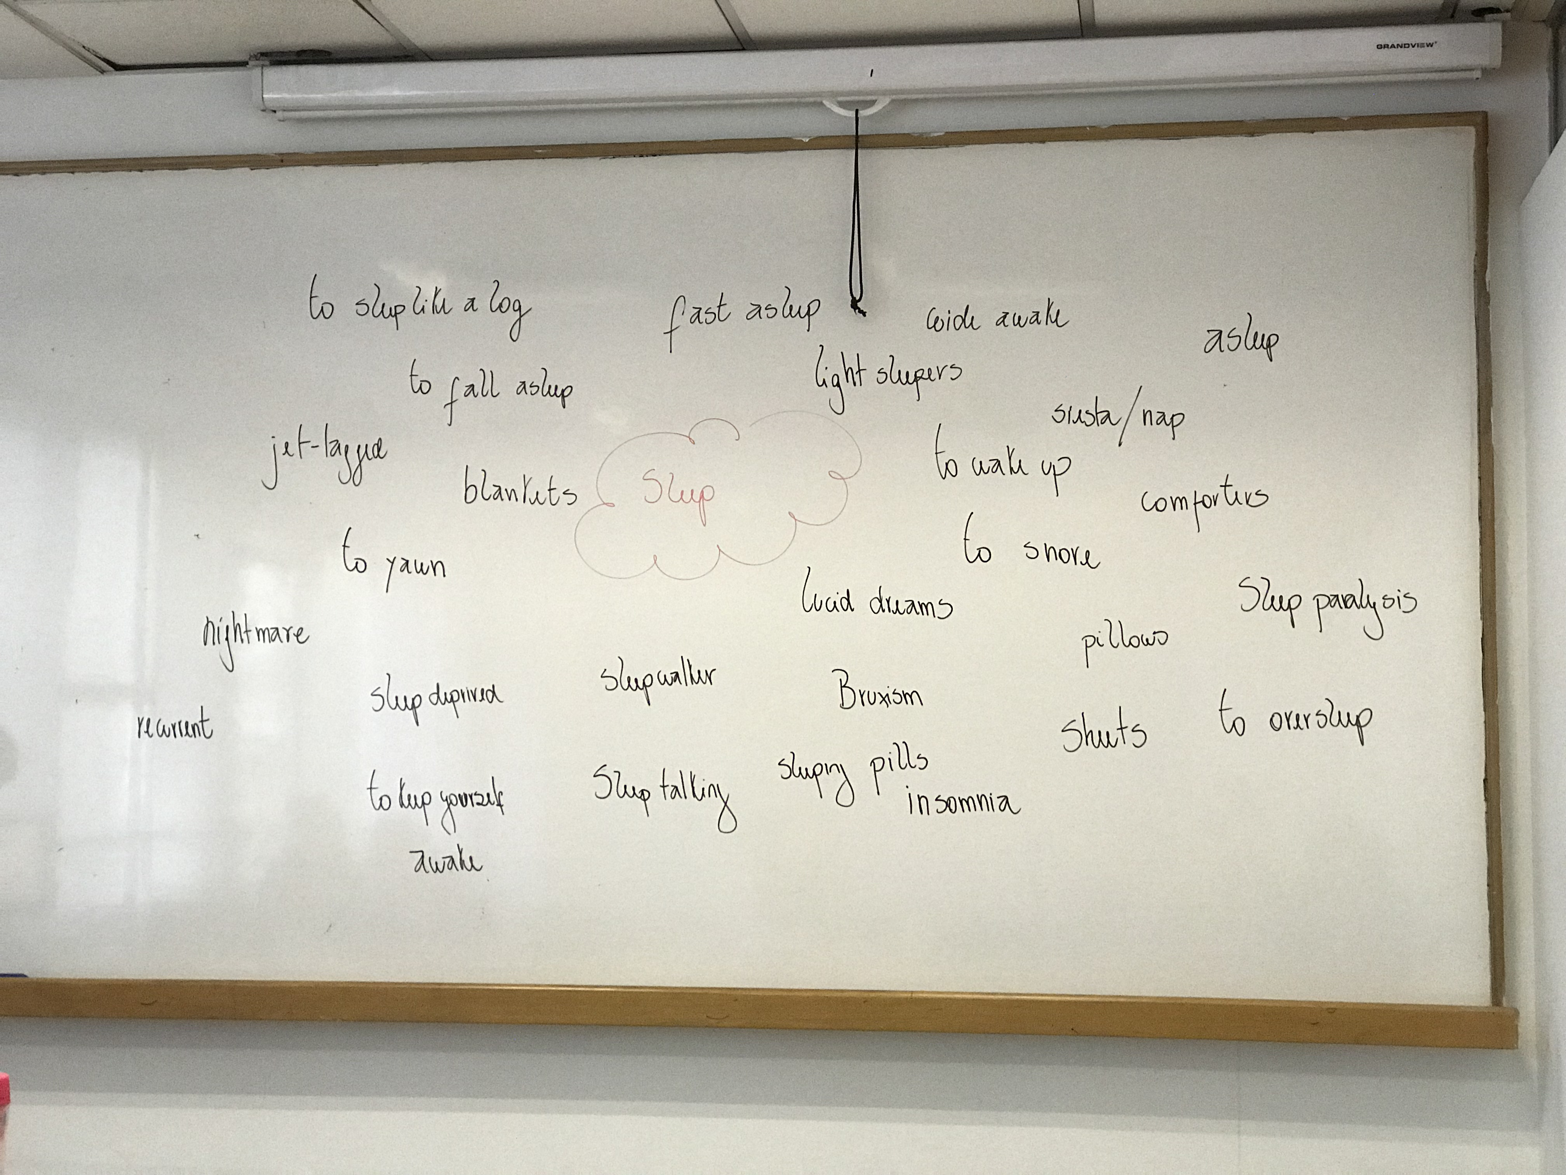

Slide 7
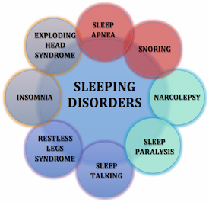

Slide 8
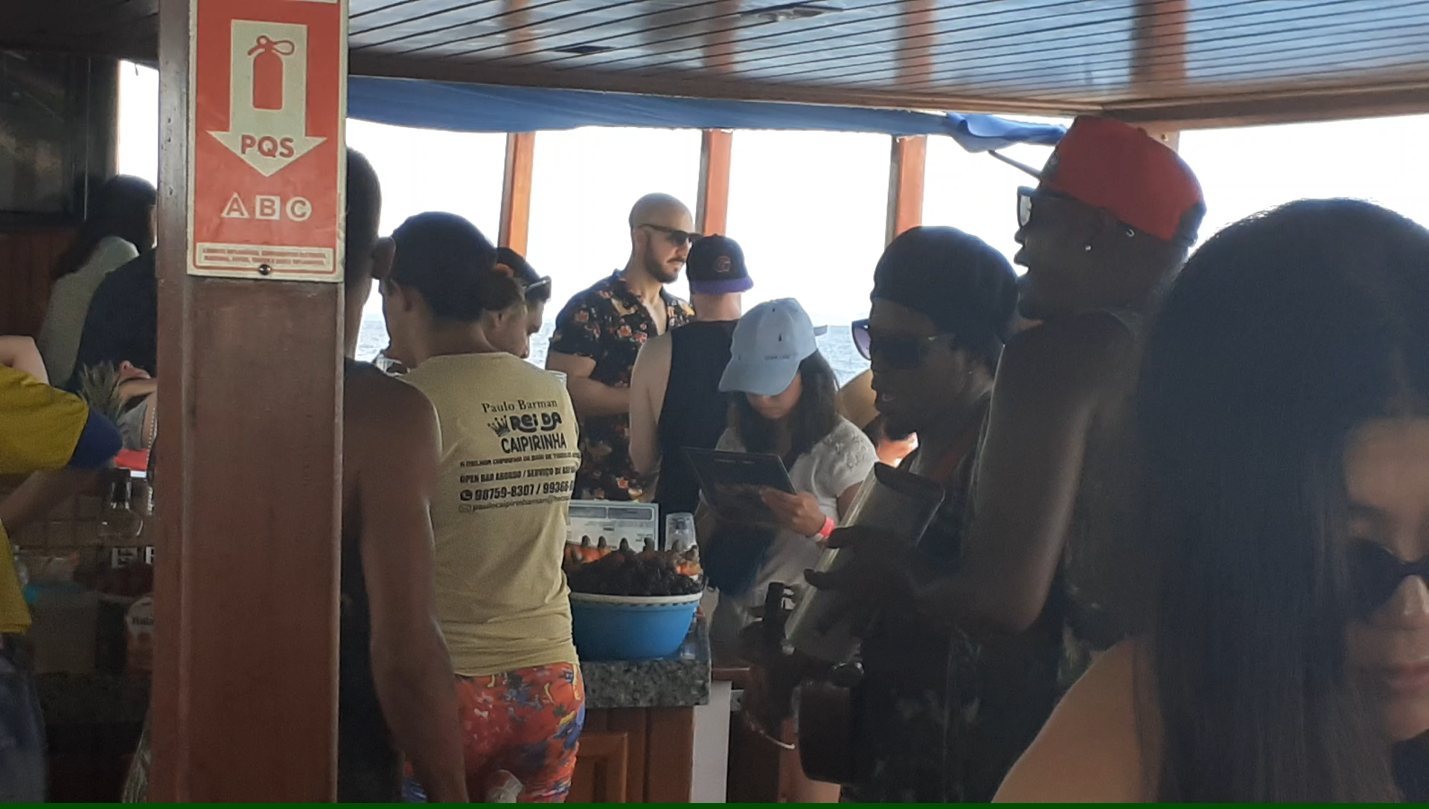
the story of my life

Slide 9
I have recently found out that my daughter suffers from 4 Sleep disorders.
Before we found out about this, I used to sleep like a log.
Now I am used to staying alert while sleeping.
And I am getting used to hearing bells every time Barbie wakes up at night.

Slide 10
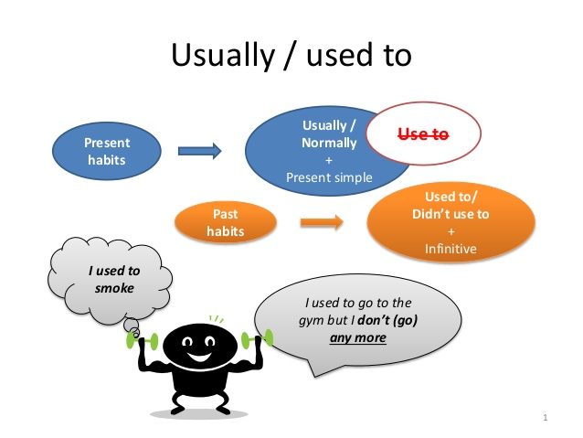
Before we found out about this, I used to sleep like a log

Slide 11
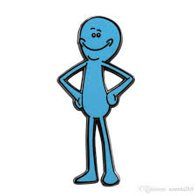
Now I am used to staying alert while sleeping
BE USED TO + V (ing)
To talk about actions/things we are familiar with
Beauchef students are used to having a vacation week in May.
Beauchef students are not used to attending all their clases.
Beauchef students were used to buying food to the tias.
Beauchef students were not used to having Zoom meetings every day.

Slide 12


And I am getting used to hearing bells everytime Barbie wakes up at night.
GET USED TO + V (ing)
To talk about actions/things we are in the process of becoming familiar with.
Beauchef students are getting used to having Zoom meetings.
Beauchef students are not getting used to the new system.
Beauchef students have not got used to having to work autonomosly yet.

Slide 13
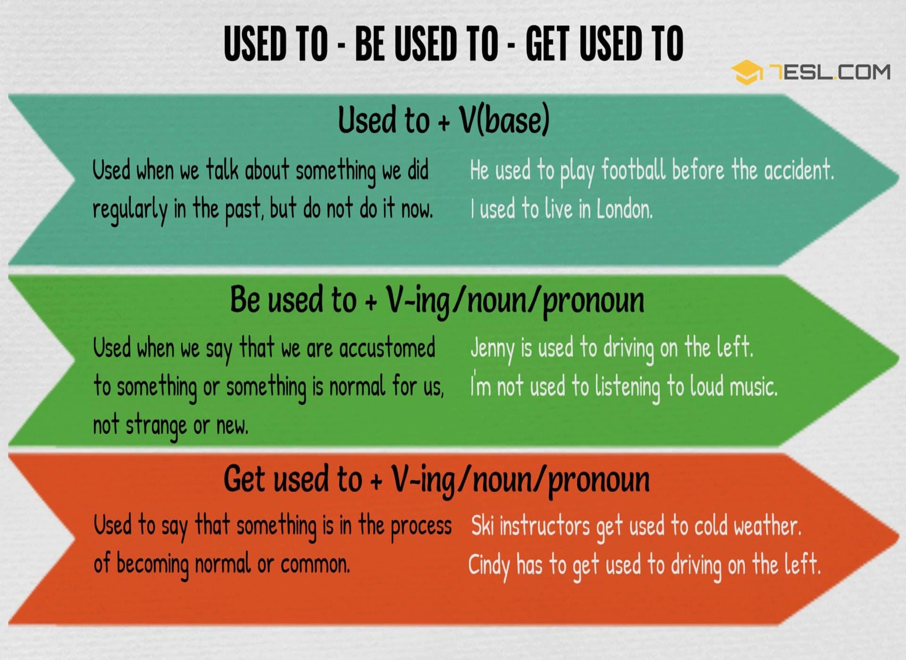

Slide 14
LET´S PRACTICE

Slide 15
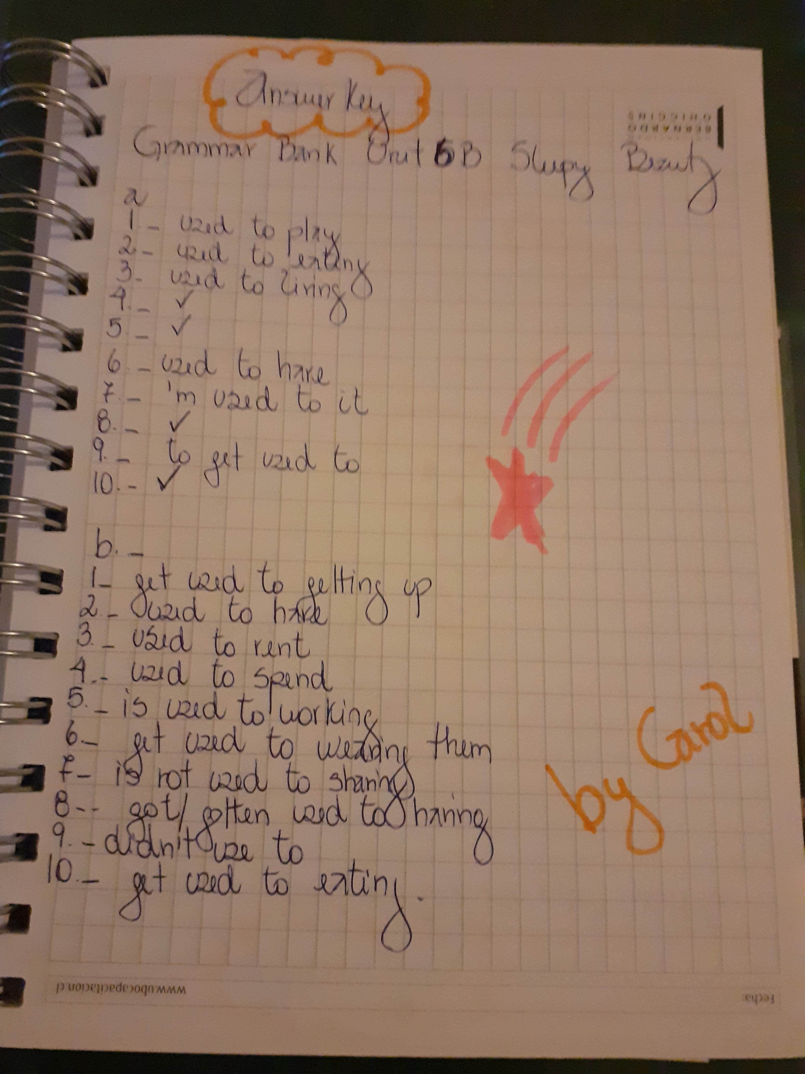

Slide 16

Still not sure about the meaning?

Slide 17
Let´s play
I have recently got a Tinder girlfriend/boyfriend
I used to
I am used to
I am getting used to

Slide 18

I have recently started having online classes.
I used to
I am used to
I am getting used to

Slide 19
The quarantine has recently been removed from my district.
I used to
I am used to
I am getting used to

Slide 20
Further practice
I have recently started my last English course
I used to
I am used to
I am getting used to

Slide 21
homework

Slide 22
homework
B How our ancestors used to sleep p.lll.
A Sleeping Beauty p.106

Slide 24
TO WANDER V/S TO WONDER
To Wander: To walk without a destination or purpose.
To Wonder: To ask yourself questions or express a wish to know about something.
TO HEAD FOR: To go in a particular direction.
TO SPILL: (Spilt) To flow, move, fall, or spread over the edge or outside the limits of something.

Slide 25
True or false

Slide 26
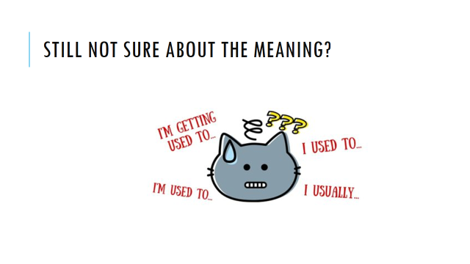

Slide 27
Further help
https://www.youtube.com/watch?v=PIYb6O-j51o
https://test-english.com/grammar-points/b1/usually-used-to-be-used-to-get-used-to/
https://speakspeak.com/english-grammar-exercises/intermediate/used-to-be-used-to-get-used-to

Slide 28
References
https://www.slideshare.net/ANSAOR/usually-used-to-would-be-used-to-get-used-to

