Slide 1
UNIT 1: Functions of the Body

Slide 2
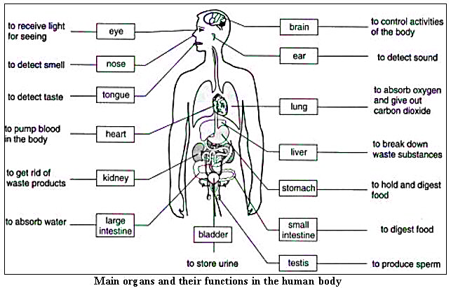

Slide 3
Body part | Definition
Bladder | It is a round, bag-like organ that stores urine.
2. Kidneys | They are the organs that filter waste products from the blood.
3. Nose | It is the part projecting above the mouth on the face of a person or animal, containing the nostrils and used for breathing and smelling
4. Eye | It is an organ which reacts to light and pressure. It allows vision.
5. Stomach | It helps digest food by mixing it with digestive juices and churning it into a thin liquid.
6. Lungs | They are a pair of spongy, air-filled organs located on either side of the chest (thorax).
7. brain | It is the central organ of the human nervous system, and with the spinal cord makes up the central nervous system.

Slide 4
The Five Senses
In addition to smell and taste, the senses include sight (or vision), hearing, and touch (also called sensation or feeling). To ask about the senses, doctors use the following questions:

Slide 6
Body part | Definition
Bladder | ___ __It is the central organ of the human nervous system, and with the spinal cord makes up the central nervous system.
2. Kidneys | ___ __It is the part projecting above the mouth on the face of a person or animal, containing the nostrils and used for breathing and smelling.
3. Nose | ______They are a pair of spongy, air-filled organs located on either side of the chest (thorax).
4. Eye | ______It is a round, bag-like organ that stores urine.
5. Stomach | ______It is an organ which reacts to light and pressure. It allows vision.
6. Lungs | ______They are the organs that filter waste products from the blood.
7. brain | ______ It helps digest food by mixing it with digestive juices and churning it into a thin liquid.
7
3
6
1
4
2
5

Slide 7
Health and Illnesses

Slide 8
English | Spanish
illness | enfermedad (concepto genérico, malestar sin diagnóstico)
disease | enfermedad (propiamente identificada, como la influenza o el cáncer)
ashtma | asma
heart attack | Ataque al corazón
heart disease | Cardiopatía
hepatitis | hepatitis
ulcer | ulcera
flu | influenza
wound | herida
injury | lesión

Slide 9
nurse | enfermera
Injection/ shot | inyección
prescription | Receta médica
painful | doloroso
painless | Indoloro
bandage | Venda
Band aid | Vendita, parche curita
wheelchair | Silla de ruedas
To feel good | Sentirse bien
To catch a cold | resfriarse

Slide 10
To sneeze | estornudar
To cough | toser
To feel sick | sentirse enfermo
To feel dizzy | sentirse mareado
To faint | desmayarse
To have backache | tener dolor de espalda
To have earache | tener dolor de oído
To have a sore throat | tener dolor de garganta
To have a stomachache | Tener dolor de estómago
To throw up | vomitar

