Slide 1
Functions of the Body

Slide 3
Body part | Definition
Bladder | It is a round, bag-like organ that stores urine.
2. Kidneys | They are the organs that filter waste products from the blood.
3. Nose | It is the part projecting above the mouth on the face of a person or animal, containing the nostrils and used for breathing and smelling
4. Eye | It is an organ which reacts to light and pressure. It allows vision.
5. Stomach | It helps digest food by mixing it with digestive juices and churning it into a thin liquid.
6. Lungs | They are a pair of spongy, air-filled organs located on either side of the chest (thorax).
7. brain | It is the central organ of the human nervous system, and with the spinal cord makes up the central nervous system.

Slide 4
The Five Senses
In addition to smell and taste, the senses include sight (or vision), hearing, and touch (also called sensation or feeling). To ask about the senses, doctors use the following questions:

Slide 5
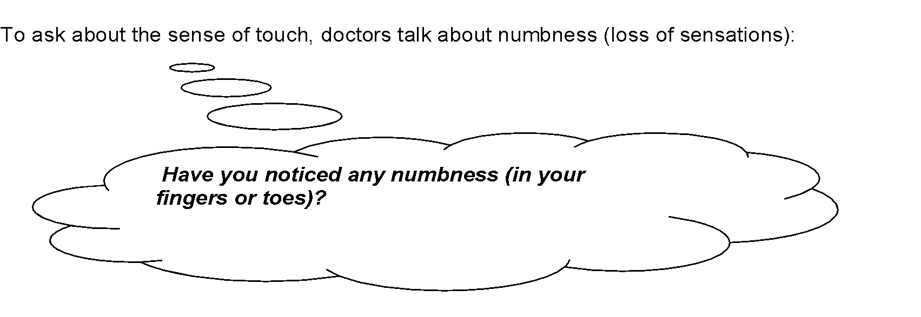

Slide 6
Do you remember the definitions?
let’s see

Slide 7
Body part | Definition
Bladder | ___ __It is the central organ of the human nervous system, and with the spinal cord makes up the central nervous system.
2. Kidneys | ___ __It is the part projecting above the mouth on the face of a person or animal, containing the nostrils and used for breathing and smelling.
3. Nose | ______They are a pair of spongy, air-filled organs located on either side of the chest (thorax).
4. Eye | ______It is a round, bag-like organ that stores urine.
5. Stomach | ______It is an organ which reacts to light and pressure. It allows vision.
6. Lungs | ______They are the organs that filter waste products from the blood.
7. brain | ______ It helps digest food by mixing it with digestive juices and churning it into a thin liquid.

Slide 8
Act out the following sequence of events
You are hungry, you are in a restaurant and the waiter brings your food.
You smell it. It stimulates your appetite, you want to eat. Your mouth waters, filling with saliva.
You take a bite of the food. It tastes good and you chew it and swallow it.
You eat more, but then suddenly you taste something unpleasant. You feel nauseous
You rush to the toilet, and get there just in time before vomiting all the food you have eaten. Something has disagreed with you

Slide 9
Health and Illnesses

Slide 10
English | Spanish
illness | enfermedad (concepto genérico, malestar sin diagnóstico)
disease | enfermedad (propiamente identificada, como la influenza o el cáncer)
ashtma | asma
heart attack | Ataque al corazón
heart disease | Cardiopatía
hepatitis | hepatitis
ulcer | ulcera
flu | influenza
wound | herida
injury | lesión

Slide 11
nurse | enfermera
Injection/ shot | inyección
prescription | Receta médica
painful | doloroso
painless | Indoloro
bandage | Venda
Band aid | Vendita, parche curita
wheelchair | Silla de ruedas
To feel good | Sentirse bien
To catch a cold | resfriarse

Slide 12
To sneeze | estornudar
To cough | toser
To feel sick | sentirse enfermo
To feel dizzy | sentirse mareado
To faint | desmayarse
To have backache | tener dolor de espalda
To have earache | tener dolor de oído
To have a sore throat | tener dolor de garganta
To have a stomachache | Tener dolor de estómago
To throw up | vomitar

Slide 13
Now let’s put this vocabulary into practice

Slide 14
Watch the video and answer these questions.
https://www.youtube.com/watch?v=VPM2WYQetEo&t=102s
How does Emily feel?
_______________________________________
What is the matter with Emily?
____________________________________________________________________________________
Does she have a sore throat?
Choose 3 sentences or important expressions from the video and write them down.

Slide 15
English | Spanish
illness
disease
ashtma
heart attack
heart disease
hepatitis
ulcer
flu
wound
injury

Slide 16
nurse
Injection/ shot
prescription
painful
painless
bandage
Band aid
wheelchair
To feel good
To catch a cold

Slide 17
To sneeze
To cough
To feel sick
To feel dizzy
To faint
To have backache
To have earache
To have a sore throat
To have a stomachache
To throw up

Slide 18
Watch this video https://www.youtube.com/watch?v=t87VGQ-NlwQ and answer the following questions:
Name Mrs Jones’ symptoms
What does the doctor prescribe her?
Complete the following questions
What seems to _________________________________?
How long have you ______________________________?

Slide 19
Most Common Illnesses

Slide 20
Tick the illnesses that are more common in your field. Then, compare with a partner. Part a
1. Hypertension ("high blood pressure")
2. Upper Respiratory Tract Infection (coughs, colds, "flu", etc.)
3. Allergies
4. Headaches
5. Diarrhea & gastrointestinal pathologies (gastroesophageal reflux disease, irritable colon, etc)
6. Bronchitis - tonsilitis
7. Degenerative Joint Disease ("arthritis", etc.)

Slide 21
Tick the illnesses that are more common in your field. Then, compare with a partner. Part b
8. Attention deficit hyperactivity disorder
9. Otitis ("ear infection")
10. Depression
11. Alzheimer’s disease
12. Anorexia nervosa
13. Back pain
14. Bipolar disorder
15. Breast cancer

Slide 22
How often are these people affected by one of these illnesses? Discuss in groups.
Example: Many senior citizens are usually affected by arthritis, especially in winter.
Or: Many senior citizens usually suffer from arthritis…
Infants (0-2 years of age):
Children 2-10 y.o.a :
Children 11-13:
Teens 14-20:
Adults 20-40:
Adults 41-60:
Seniors 61 + :

Slide 23
And what about you? How often do you suffer from a common illness? Which one(s) affects you more often? Compare your answers with a partner.
For example:
A: I always get allergies in spring. What about you?
B: No, I don’t, but I usually get asthma in winter.

