Slide 1
Verb to be possessive adjectives and pronouns

Slide 3
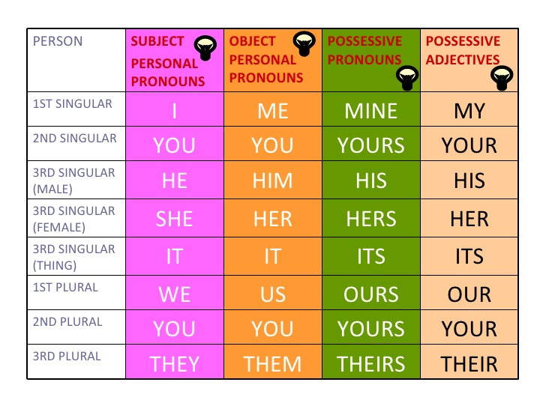

Slide 4
Extra practice
https://play.kahoot.it/v2/lobby?quizId=18de1387-0d7a-44fe-9cd4-5875e34d3b2e
https://play.kahoot.it/v2/lobby?quizId=4fe7d266-ba8e-4484-8221-7aa5427370f7

