Slide 1
Inglés Pre Intermedio (CEFL b1)
Explaining Visual Aids

Slide 2
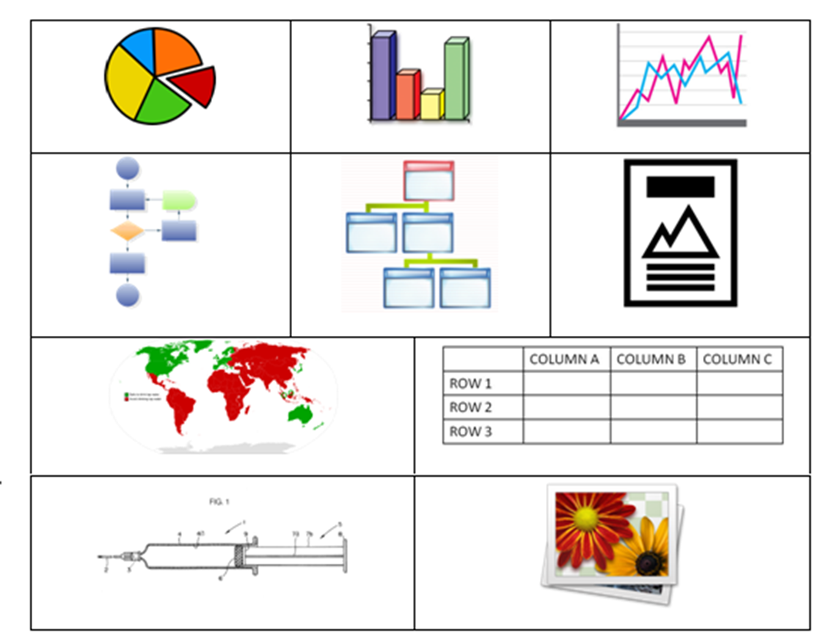
Pie chart/graph
Bar graph
Line graph
Organizational chart
Organigram
Flow chart
Poster/chart
Map
(Double-entry) table
(Technical) drawing
Picture/image/figure*
Connect these names with the type of visual aids above:

Slide 3
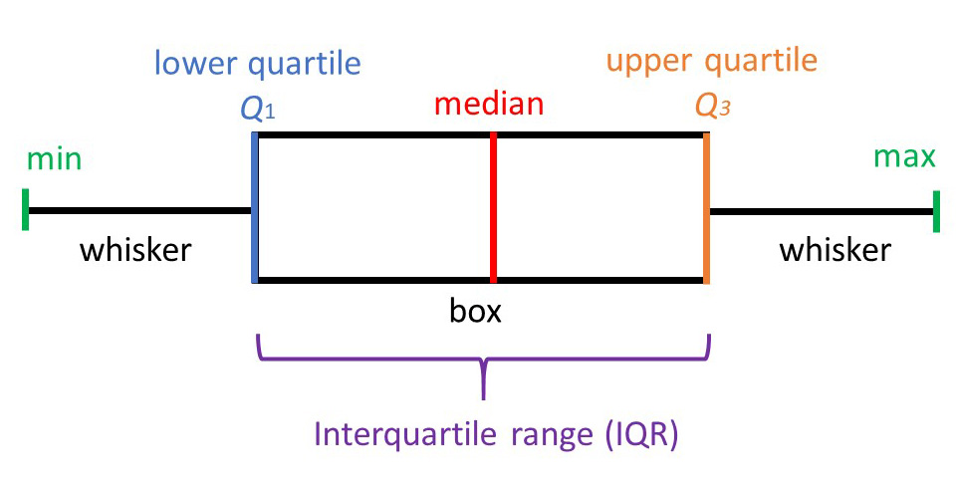
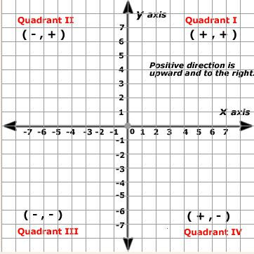
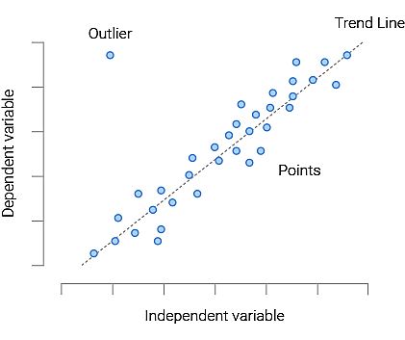
Others:
Box Plot
Venn Diagram
Cartesian Plane
Scatter Plot

Slide 4
In the upper right corner
In the center
On the left
On the right
In the bottom left corner
Across the top
On the top
Down the right side of the slide
Across the bottom
On the bottom

Slide 5
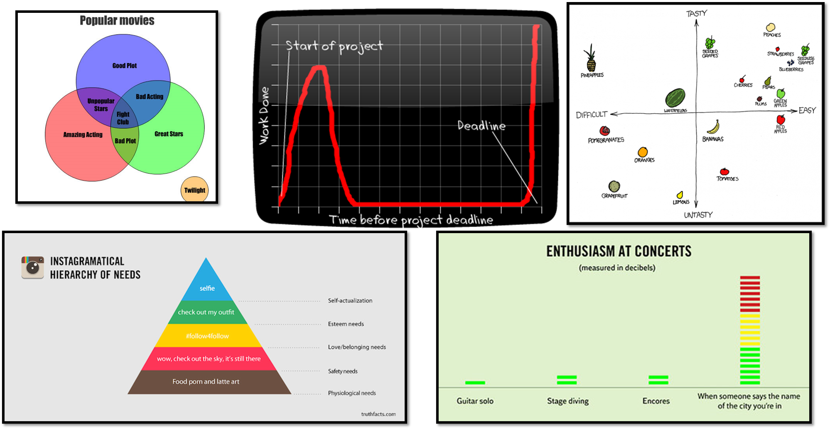
Practice 1: Where is the information?

Slide 6
Practice 2: Choose one of the following graphs and explain it with your partners in passive voice.

Slide 7
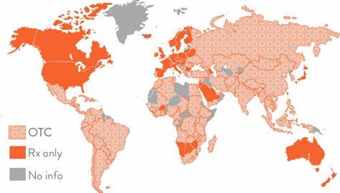
Birth control pills over-the-counter availability around the world
*OTC = over the counter. Rx only = prescription only.

Slide 9
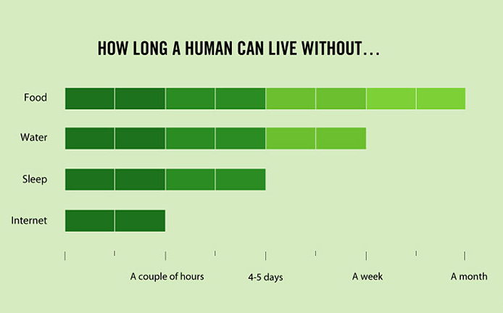

Slide 10
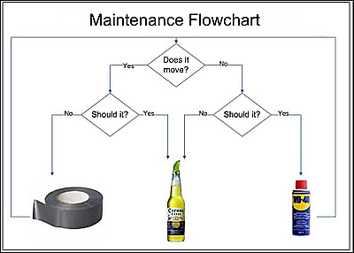

Slide 13
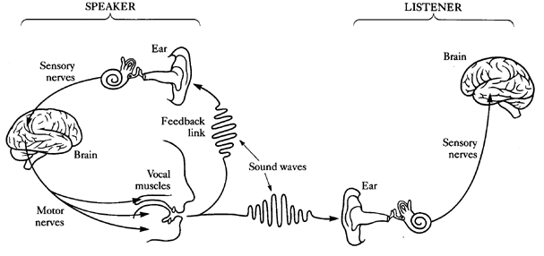

Slide 14
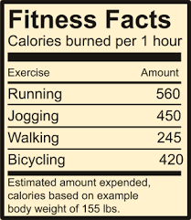

Slide 16
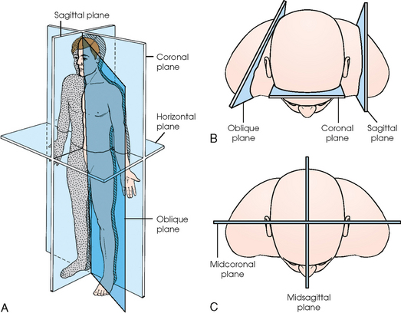

Slide 17
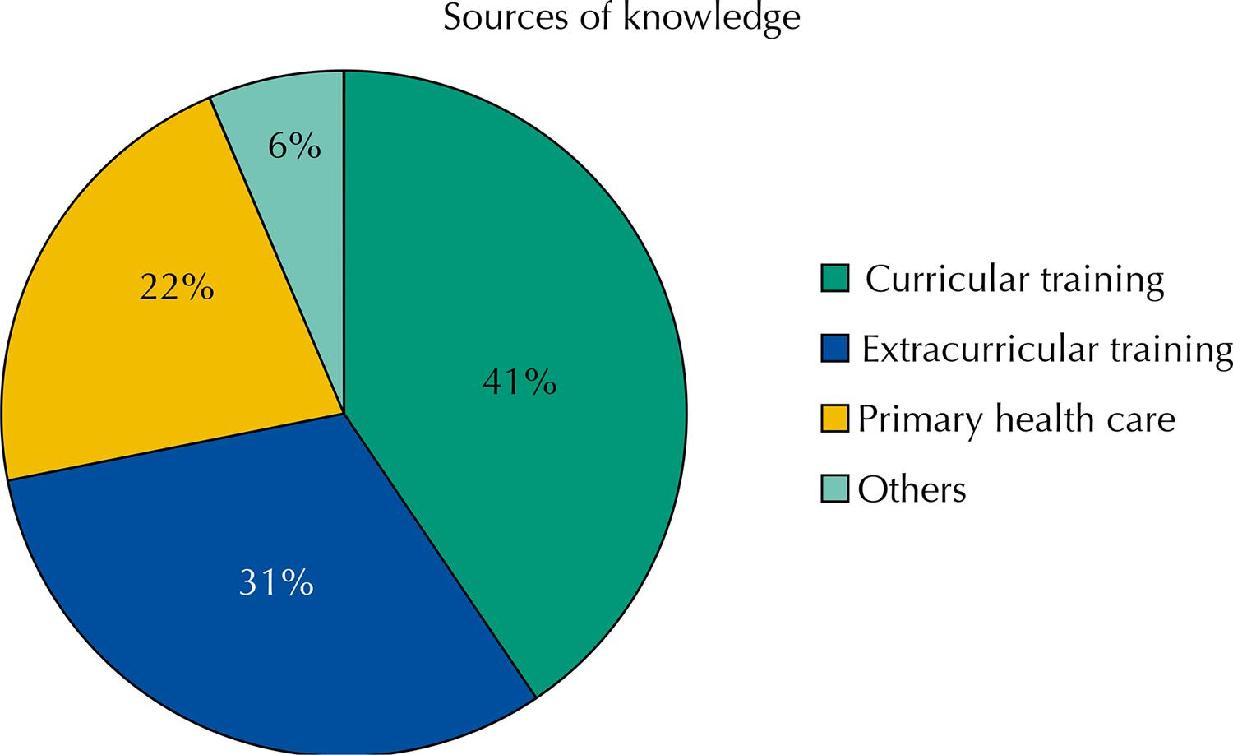
Figure 2 [Chilean Public] University students’ source of knowledge on health team members in primary care, 2013.

