Slide 1
Inglés Pre Intermedio (CEFL b1)
Unit 4: Connectors and Sequencers

Slide 2
Sequencers

Slide 3
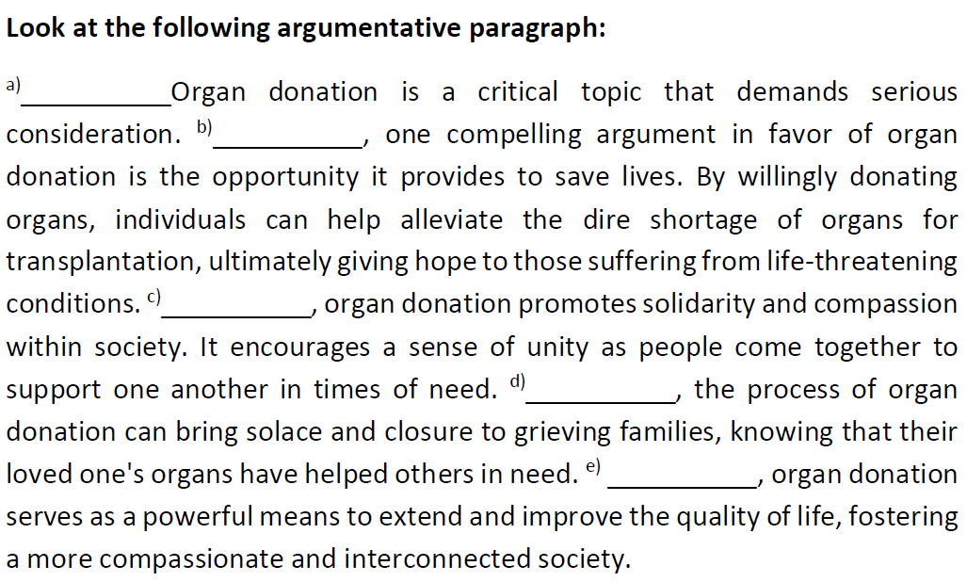

Slide 4
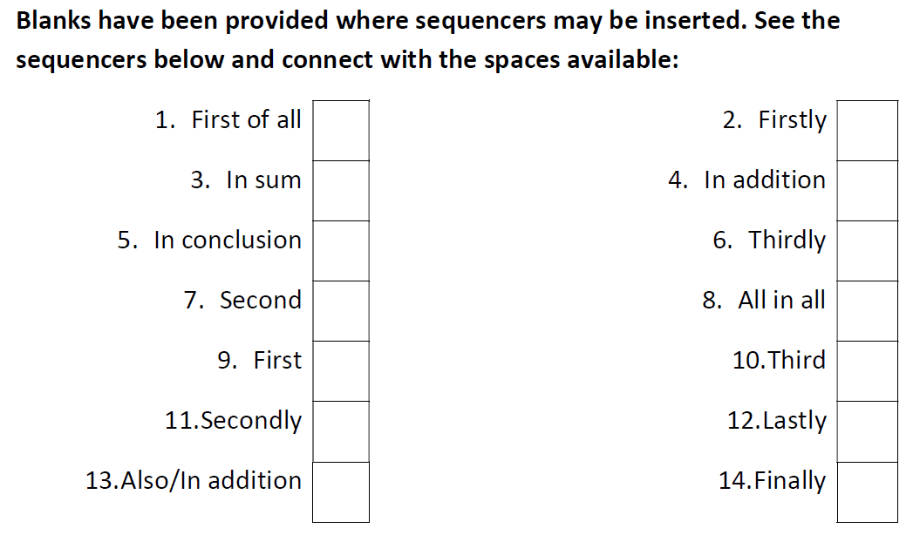

Slide 6
Connectors
The next slides contain connectors used in context for you to study the meaning, use, and punctuation.

Slide 7
The minister claimed that the hospital was safe, but they were still not prepared to receive patients. OR
The minister claimed that the hospital was safe. However, they were still not prepared to receive patients.
Jackson stopped using his medicine, so his condition worsened. OR
Jackson stopped using his medicine. Therefore, his condition worsened.
She does not eat crab because she is allergic to seafood. OR
She does not eat crab because of her allergy to seafood. OR
She does not eat crab due to her allergy to seafood.

Slide 8
In comparison with/to reptiles and fish, the cerebellum of birds shows high development. OR
The cerebellum of birds shows high development in comparison with/to reptiles and fish.
The patient must lose weight. Otherwise, he will not qualify for surgery.
Her family decided not to buy the prescrption. Instead, they turned to herbal tea and some other home remedies.
Even though new policies have been issued, inclusion and accessibility have not been properly developed by public medical centers.

Slide 9
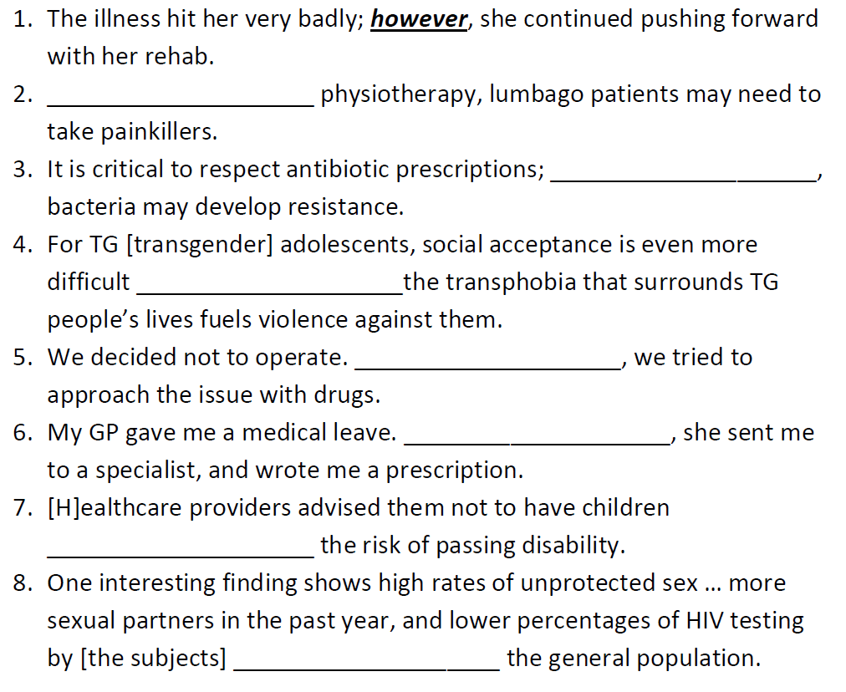

Slide 10
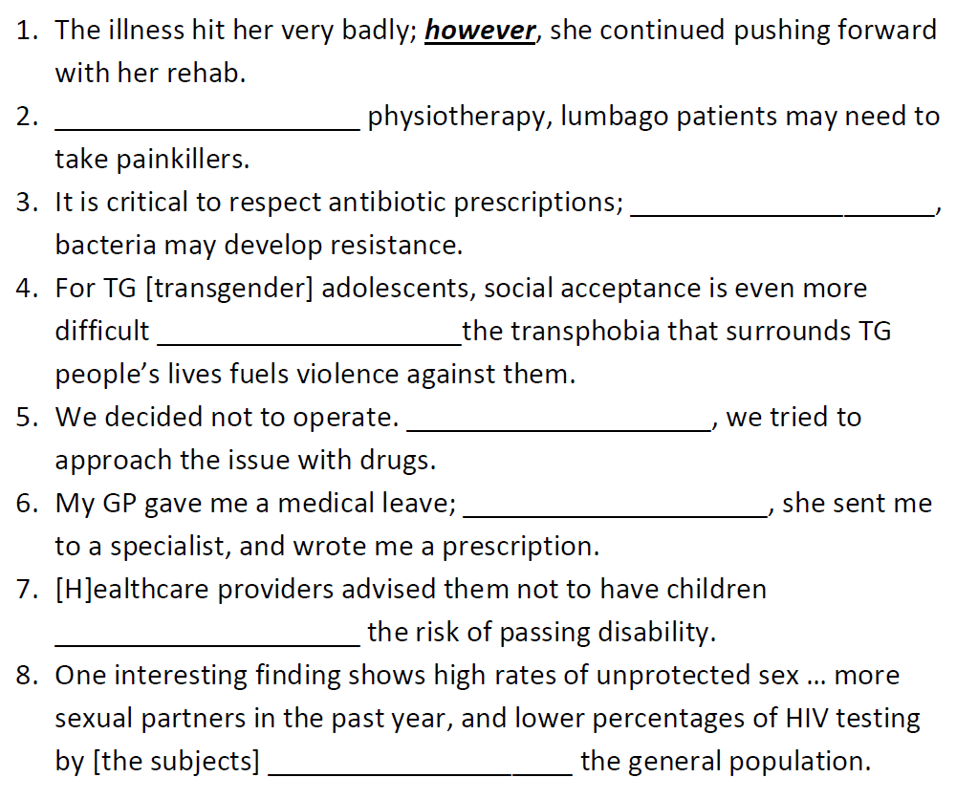
In addition to
otherwise
because
Instead
in addition
because of
in comparison to

Slide 11
Complete the prompts with your own ideas.
The lesion was not visible in the X-rays; however, …
The nutritionist recommended to cut down on junk food; in addition, …
The hospitalization rate due to . . . was 4 per 100 000 infants.
Singers must make sure they learn proper voice techniques; otherwise, …
You do not need to always obtain protein from animal sources; instead, …
In comparison to swimming, …
In addition to . . . , …
Workplace harassment policies are needed because …

