Slide 1

English Intermediate
week 2

Slide 2
The Paragraph
The paragraph is a unit of writing that clusters around one main point. The theme of the paragraph may be found in the topic sentence, which is usually the first or second sentence in the paragraph.
The 2 parts of the topic sentence are the topic or the main point that will be talked about in the paragraph and the controlling idea, which denotes the boundaries that restrict the scope of the paragraph.

Slide 3
Topic: University Life
Topic Sentence: “University life demands changes in students’ lifestyles”
This topic sentence restricts the topic to changes people may have to make to adapt to university life.
This topic sentence makes it impossible to talk about your favorite subject at university, how old the university is or the look of the university campus.

Slide 4
The next part in the paragraph is the supporting ideas, usually 3, that develop different aspects of the same topic sentence. In the previous example, some changes in lifestyle may include changes in diet (which can be expressed in one sentence), changes in sleeping habits (which should be expressed in a different sentence), and changes in romantic life (which, again, must be expressed in a different sentence).
The final part of the paragraph is the conclusion, which rounds up the idea of the paragraph. As this idea was expressed succinctly in the topic sentence, a good rule of thumb is that a good conclusion expresses the same idea of the topic sentence with different words.

Slide 5
Find some science-related topics to practise the relationship among these parts of the structure of a paragraph below.
1. GMOs
2. Mental Health
3. Public and Private Health Care System in Chile

Slide 6
The components of a paragraph may be organized in an outline as follows:
Paragraph outline
TS Telemedicine is not the panacea
SI -1 Inability to perform physical exams
SI -2 Lack of access
SI -3 Digital illiteracy
CS A multifaceted approach to healthcare delivery is required.

Slide 7
Paragraph Outline Number 1 TS: ___________________________________________________ SI 1:___________________________________________________ SI 2:___________________________________________________ SI 3: __________________________________________________ CS: __________________________________________________

Slide 8
Paragraph Outline Number 2 TS: ___________________________________________________ SI 1:___________________________________________________ SI 2:___________________________________________________ SI 3: __________________________________________________ CS: __________________________________________________

Slide 9
Paragraph Outline Number 3 TS: ___________________________________________________ SI 1:___________________________________________________ SI 2:___________________________________________________ SI 3: __________________________________________________ CS: __________________________________________________

Slide 10
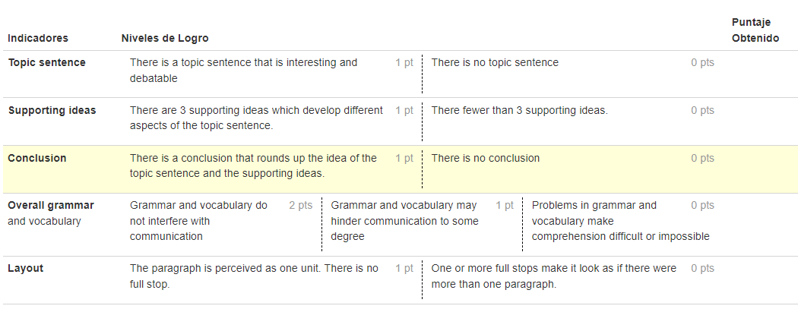
Rubric

