Slide 1
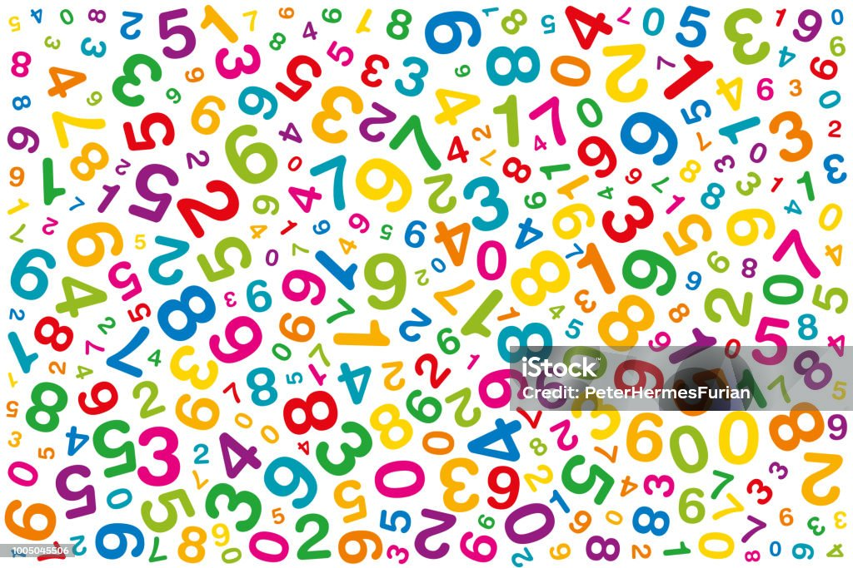
BIG NUMBERS AND SOME SYMBOLS

Slide 2
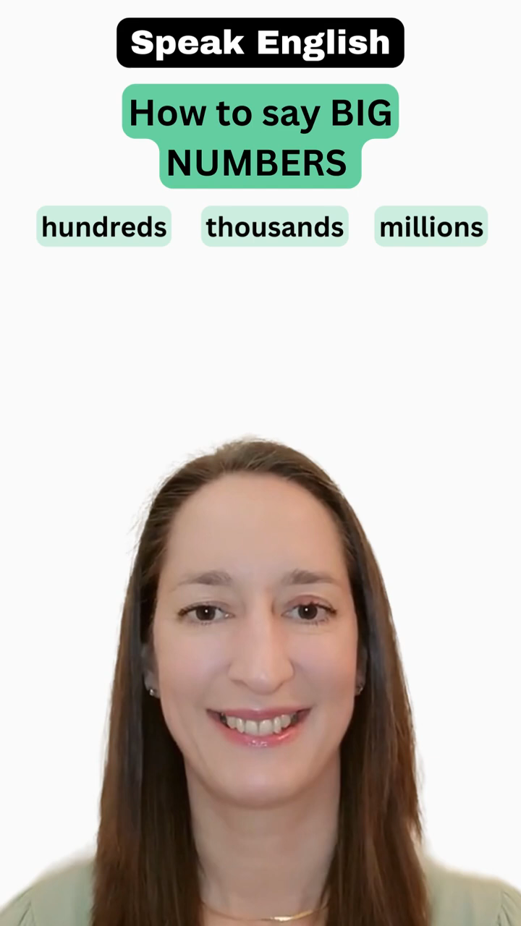
Watch the following video and say the numbers she mentions:

Slide 3
Do the exercises your teacher will choose:
https://agendaweb.org/vocabulary/numbers-big-exercises.html

Slide 4
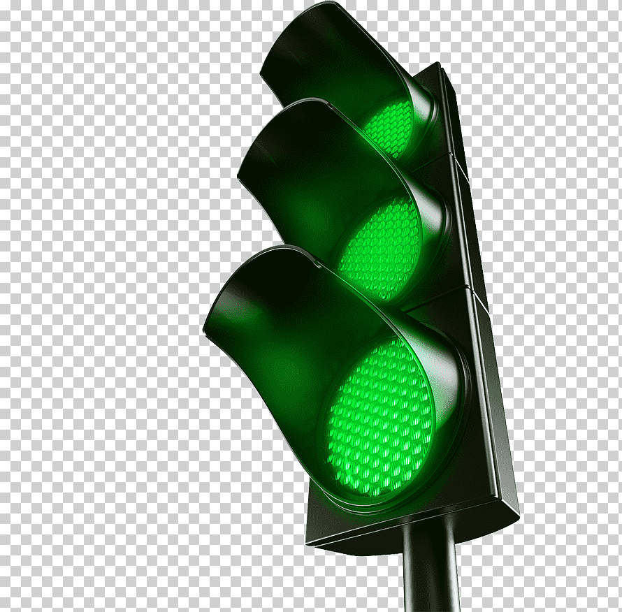
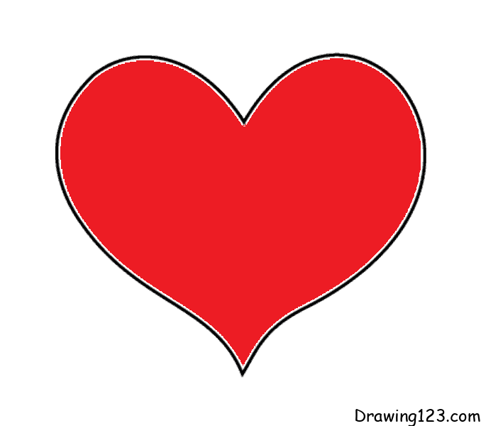
“Symbols in Everyday Life”
Symbols are all around us in our daily lives. A symbol is something that represents an idea or a concept. For example, a heart shape often represents love, and a green traffic light symbolizes "go." Understanding symbols helps us communicate and navigate the world.
Think about the stop sign. It is a red octagon with the word "STOP" written in white. What does this symbol mean? It means that you must bring your vehicle to a complete halt*. Without words, the red octagon sends a clear message to drivers.
Symbols are not just on road signs; they are in our language too. The smiley face :) is a symbol used in texts and messages to show happiness. Similarly, a sad face :( represents sadness. These symbols make it easy to express emotions without using many words.

Slide 5
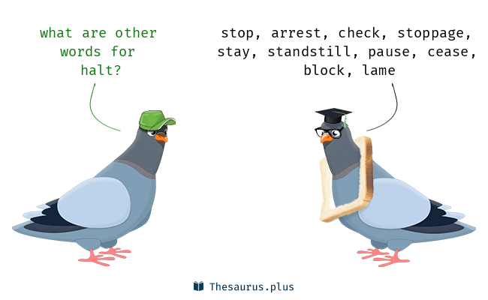
Answer the following questions:
1. What is a symbol?______________________________________________________
2. Can you give an example of a symbol from the text? ______________________________________________________________________
3. What does a red stop sign with the word "STOP" written in white symbolize?
______________________________________________________________________
4. Where else, besides road signs, can you find symbols? ______________________________________________________________________
5. Explain the meaning of the smiley face :) and the sad face :( in the text.
___________________________________ ____________________________________
6. Why are symbols important in communication? _______________________________________________________________________

Slide 6
Here´s a brief list of basic symbols and abbreviations used in online communication.
1. :) or :-)
Meaning: Smile
Example: "I had a great day at the park today :)"
2. :( or :-(
Meaning: Sad or unhappy
Example: "I couldn't find my keys. :( "
3. :D or :-D
Meaning: Big smile or laughter
Example: "Your joke was funny :D"
4. ;) or ;-)
Meaning: Wink
Example: "I'll see you soon ;)"
5. LOL
Meaning: Laugh out loud
Example: "That joke was so funny, I couldn't stop LOL."

Slide 7
6. BRB
Meaning: Be right back
Example: "I need to grab a snack, BRB."
7. OMG
Meaning: Oh my goodness
Example: "OMG, I can't believe you did that!"
8. BTW
Meaning: By the way
Example: "BTW, have you seen the new movie?"
9. TTYL
Meaning: Talk to you later
Example: "I have to go now, TTYL!"
10. IDK
Meaning: I don't know
Example: "Someone asked me about it, but IDK."

Slide 8
THE END ☺

