Slide 1
PAST SIMPLE AND PAST CONTINUOUS

Slide 2
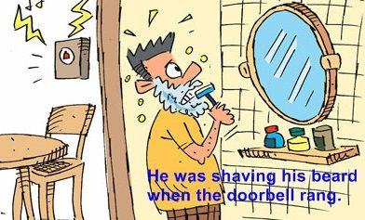
There are two kinds of past tenses:
1.- The Simple Past
2.- The Past Continuous or Progressive

Slide 3
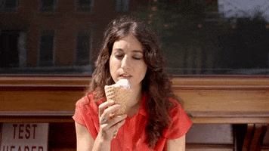
We use the past simple to talk about events, states or habits which finished at definite times in the past.
SIGNAL WORDS/EXPRESSIONS
Yesterday, last week, a month ago, in 2002, the day before yesterday, then.
Ex: She ate a lot of ice cream last month.

Slide 4
- The past continuous shows us that the action was already in progress at a certain time in the past. What were you doing at 8 p.m. last night? I was studying. This means that I started studying before 8 p.m. and I continued after 8 p.m. - The past continuous can also show that an activity was in progress for some time, not just for a moment. We were cleaning the house all morning - The past continuous is very easy to identify because it has the verb to be in past and the present of the main verb+ing She was working as a lawyer… when we met. (BE in past)+ WORK ending in ING
THE PAST CONTINUOUS
WAS / WEWAS / WERE + V-ING
RE WAS / WERE
WAS / RE + V-ING
+ V-ING

Slide 6
The Past Continuous and Past Simple can interact in a sentence.
SIGNAL WORDS:
When and while
When is used in past simple to interrupt the action expressed in past continuous:
Ex: I was studying in my bedroom when I heard a strange noise.
While goes together with the past continuous and can also accompany the past tense part.
Ex: While I was studying in my bedroom, I heard a strange noise.

Slide 7
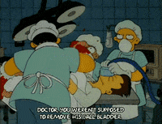
Sometimes, while is used when two events happen simultaneously.
Ex: While the surgeon was operating the patient, his family was waiting.

Slide 8
Watch this video, now:
https://www.youtube.com/watch?v=uTB5I8V9Eog&t=236s

Slide 9
Now, it's your turn to do the exercises on pages 21, 22, 23 and 24.

