Slide 1
SIMPLE PRESENT VS PRESENT CONTINUOUS

Slide 3
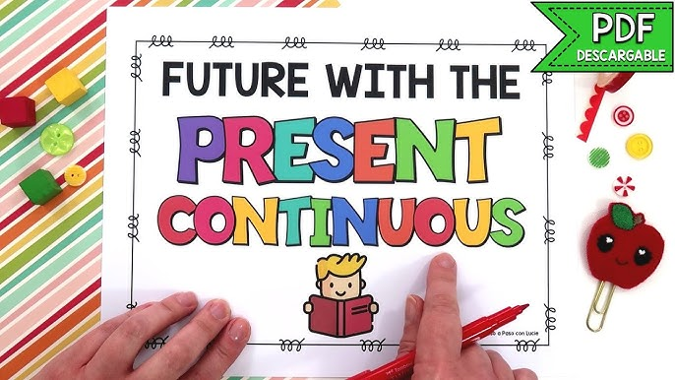
Using the present continuous to talk about the future
The present continuous is used to talk about arrangements for events at a time later than now. There is a suggestion that more than one person is aware of the event, and that some preparation has already happened. e.g.
I'm meeting Jim at the airport = Jim and I have discussed this.
I am leaving tomorrow. = I've already bought my train ticket.
We're having a staff meeting next Monday = all members of staff have been told about it.
He isn't working tomorrow = Because, he arranged a doctor appointment.

Slide 4
Some verbs are NOT used in the Continuous Tenses. These are called STATIVE verbs. See the chart below:

Slide 5
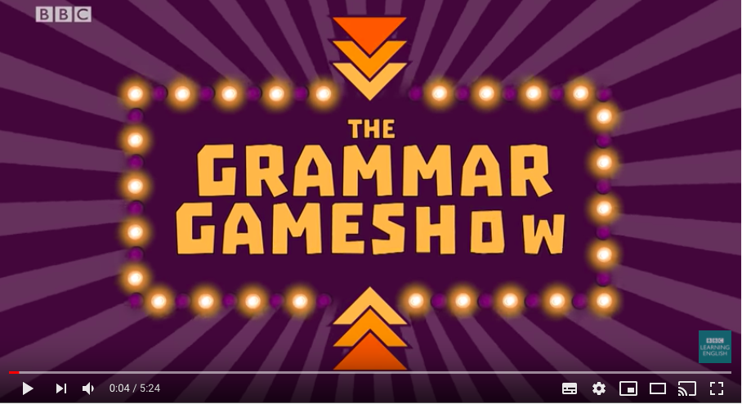
Now, watch this video:
https://www.youtube.com/watch?v=OsW5sV3GMDM&t=11s

Slide 6
Now, do the exercises on pages 15 and 16.

