Slide 1
Inglés Pre Intermedio (CEFL b1)
Unit 4: Parts of an abstract

Slide 2
Parts of an Abstract

Slide 3
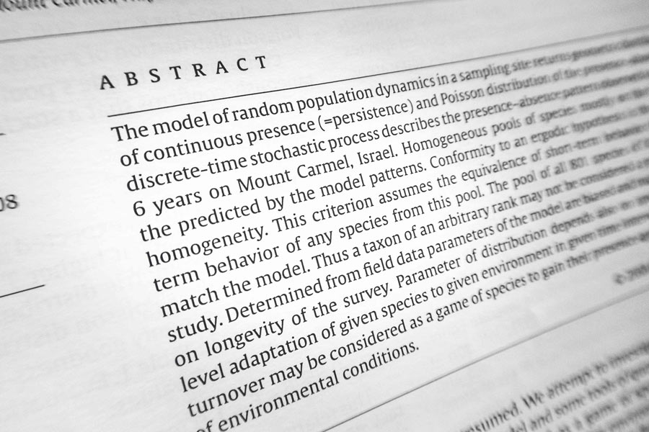
What is an abstract?
An abstract is a mini-text which gives the| reader a short summary of a study, its methodology, and main findings.
Why is it important?
It is important because it is a screening device that helps the reader to decide if they want to read the whole article or not. It is a preview of the whole article (road-map).

Slide 4
An abstract may answer all these questions.
Discuss with your partners what section of an abstract answers what questions.
 | What do the findings mean?
 | What was discovered?
 | What is the study about? Why did you do this study?
 | What do we know about the topic? Why is the topic important?
 | How was the study done?
Conclusion or discussion
Results or findings
Purpose or objectives
Introduction or background
Methods
The options are the following: Introduction or background
Purpose or objectives
Methods
Results or findings
Conclusion or discussion

Slide 5
Parts of an abstract
Abstracts are usually divided the following way:
Introduction/background: What do we know about the topic? Why is the topic important?
Purpose/objectives: What is this study about? Why did you do this study?
Methods: How was the study done? Sometimes, in your area, this section will be referred to as Methods and Materials.
Results/findings: What was discovered?
Discussion/conclusions: What do the findings mean?
Sometimes the Discussion and the Conclusion are considered as two separate sections.

Slide 6
Look at the following example:

Slide 7
Low-back pain injury is responsible for most lost workdays and injury compensation claims. The use of back support belts has been forwarded as a countermeasure towards reducing low-back injuries in the industrial setting. The purpose of this study was to determine if a back support belt relieves stress encountered by lumbar spine during stoop type lifting and potentially reduce the risk of injury. Twelve male participants (49.7 +- 3.7 years) performed two sessions of stoop type lifting with a loaded milk crate (11.5 km), at four repetitions per minute, for fifteen minutes in accordance with the NIOSH lifting equation. One lifting session was performed without the support belt, while the other with a support belt. Three sets of fluoroscopic images were collected with the participants positioned at the initiation (flexed trunk), mid-ranged, and completion of the lift (erect standing). The first series of images were collected under a non-load condition, while the second (non-support belt) and third series (support belt) were collected with the participants lifting the 11.5 kg milk crate. Images were imported into AutoCAD where lumbar disc deformation and joint angles were measured by calculating changes in position of adjacent vertebrae (L3-4 and L4-5). A reduction of disc deformation was deemed indicative of reduce stress. Analysis of variance revealed that compressive and shear disc deformation were reduced while in the erect trunk posture for the support belt condition (p<0.005). No significant reduction in disc deformation was present while in flexed trunk posture for the support belt condition (p>0.005). During stoop type lifting, support belts provides a measurable amount of stress reduction of the lumbar spine when the trunk is in the erect posture, with little effect during flexed trunk positions.
Taken from: http://epublications.bond.edu.au/cgi/viewcontent.cgi?article=1467&context=hsm_pubs

Slide 8
Could you identify the different parts of an abstract?

Slide 9
Introduction/background
Purpose/objectives
Low-back pain injury is responsible for most lost workdays and injury compensation claims. The use of back support belts has been forwarded as a countermeasure towards reducing low-back injuries in the industrial setting. The purpose of this study was to determine if a back support belt relieves stress encountered by lumbar spine during stoop type lifting and potentially reduces the risk of injury. Twelve male participants (49.7 +- 3.7 years) performed two sessions of stoop type lifting with a loaded milk crate (11.5 km), at four repetitions per minute, for fifteen minutes in accordance with the NIOSH lifting equation. One lifting session was performed without the support belt, while the other with a support belt. Three sets of fluoroscopic images were collected with the participants positioned at the initiation (flexed trunk), mid-ranged, and completion of the lift (erect standing). The first series of images were collected under a non-load condition, while the second (non-support belt) and third series (support belt) were collected with the participants lifting the 11.5 kg milk crate. Images were imported into AutoCAD where lumbar disc deformation and joint angles were measured by calculating changes in position of adjacent vertebrae (L3-4 and L4-5). A reduction of disc deformation was deemed indicative of reduce stress. Analysis of variance revealed that compressive and shear disc deformation were reduced while in the erect trunk posture for the support belt condition (p<0.005). No significant reduction in disc deformation was present while in flexed trunk posture for the support belt condition (p>0.005). During stoop type lifting, support belts provides a measurable amount of stress reduction of the lumbar spine when the trunk is in the erect posture, with little effect during flexed trunk positions.
Methods
Results
Conclusion

Slide 10
SELF- STUDY
In the following table you will find excerpts from two different scientific articles. Identify the section these excerpts belong to:
Background/Introduction – Purpose/Objective – Methods – Results – Discussion/Conclusions
To examine long-term quality of life after bilateral prophylactic mastectomy, we mailed surveys to 195 women who had the procedure from 1979 to 1999 and to a random sample of 117 women at increased breast cancer risk who did not have the procedure. Measures were modeled on or drawn directly from validated instruments designed to assess quality of life, body image, sexuality, breast cancer concerns, depression, health perception, and demographic characteristics. We used logistic regression to examine associations between quality of life and other domains.
Methods
To explore the course of psychological distress and body image at long-term follow-up (6–9 years) after prophylactic mastectomy and breast reconstruction (PM/BR) in women at risk for hereditary breast cancer, and to identify pre-PM risk factors for poor body image on the long-term.
Objective
Bilateral prophylactic mastectomy in women with increased breast cancer risk dramatically reduces breast cancer occurrence but little is known about psychosocial outcomes.
Background

Slide 11
Background/Introduction – Purpose/Objective – Methods – Results – Discussion/Conclusions
Breast cancer specific and general distress significantly decreased from T0 to T1 as well as from T1 to T2. Problems regarding breast related and general body image were significantly higher at T1 than at T0. Subsequently, breast related body image scores significantly decreased from T1 to T2, while the decrease in general body image scores were not significant. Active coping and seeking social support were predictive of lower scores (i.e. less problems) on breast related and general body image at long-term follow-up. Furthermore, higher scores on general body image before PM/BR were predictive for increased general body image scores at long-term follow-up.
Results
Our findings indicate that psychological distress is decreased after PM/BR, at the cost of persistent problems regarding body image. Exploration of coping styles and body image perception before PM/BR may help to identify vulnerable women who may benefit from additional support.
Conclusion

Slide 12
The following example shows you key language to identify each part.
Let’s analyze each section of an abstract taken from a paper titled:
Predictors of shoulder level after spinal fusion in adolescent idiopathic scoliosis.
Can you identify what sections they are?

Slide 13
Description of the problem
BACKGROUND:
For patients with adolescent idiopathic scoliosis, shoulder balance influences their treatment satisfaction and psychological well-being. Several parameters are known to affect postoperative shoulder balance, but few prognostic models are as yet available.
Status Quo
The need for research

Slide 14
For example:
-to identify
-to compare
-to evaluate
-to describe
Etc.
= aim
An action in infinitive is usually used
PURPOSE:
This study aimed to identify independent predictive factors that can be used to assess preoperatively which patients are at risk of postoperative shoulder elevation, and to build a linear prediction model.

Slide 15
Tests, techniques or instruments used
METHODS:
N = 102 patients with all Lenke types were reviewed radiographically before surgery and 1 year afterward. The outcome measures were coracoid height difference (CHD), clavicular angle (CA), and clavicle-first rib intersection difference (CiRID). Predictive factors commonly used in the literature were investigated using correlation analysis and statistical testing. Significant contributing factors were included in three multiple linear regression models (for CHD, CA, and CiRID).
Variables to be measured

Slide 16
Data obtained:
-statistics
-figures
-discoveries
What was observed
RESULTS:
The mean shoulder level (CHD) significantly changed from a lower left shoulder value of -8.5 mm before surgery to 3.3 mm at the follow-up examination. A high preoperative left shoulder level by CiRID, a large amount of Cobb angle correction of the distal thoracic curve, a low preoperative Cobb angle in the lumbar curve, and a structural proximal thoracic curve proved to be determinants and thus risk factors for left-sided shoulder elevation after surgery. The three models predicting CHD, CA, and CiRID at the follow-up examination included these four risk factors and were significant.

Slide 17
Facts established by the study
CONCLUSIONS:
Preoperative variables have the strongest influence on shoulder level after spinal instrumentation. Additionally, extensive correction of the distal thoracic curve can cause elevation of the left shoulder.
Correlations and causal relationship determined by the research

Slide 18
BACKGROUND:
For patients with adolescent idiopathic scoliosis, shoulder balance influences their treatment satisfaction and psychological well-being. Several parameters are known to affect postoperative shoulder balance, but few prognostic models are as yet available.
PURPOSE:
This study aimed to identify independent predictive factors that can be used to assess preoperatively which patients are at risk of postoperative shoulder elevation, and to build a linear prediction model.
METHODS:
N = 102 patients with all Lenke types were reviewed radiographically before surgery and 1 year afterward. The outcome measures were coracoid height difference (CHD), clavicular angle (CA), and clavicle-first rib intersection difference (CiRID). Predictive factors commonly used in the literature were investigated using correlation analysis and statistical testing. Significant contributing factors were included in three multiple linear regression models (for CHD, CA, and CiRID).
RESULTS:
The mean shoulder level (CHD) significantly changed from a lower left shoulder value of -8.5 mm before surgery to 3.3 mm at the follow-up examination. A high preoperative left shoulder level by CiRID, a large amount of Cobb angle correction of the distal thoracic curve, a low preoperative Cobb angle in the lumbar curve, and a structural proximal thoracic curve proved to be determinants and thus risk factors for left-sided shoulder elevation after surgery. The three models predicting CHD, CA, and CiRID at the follow-up examination included these four risk factors and were significant.
CONCLUSIONS:
Preoperative variables have the strongest influence on shoulder level after spinal instrumentation. Additionally, extensive correction of the distal thoracic curve can cause elevation of the left shoulder.

