Slide 1
Discuss the following questions with your partner:
Why did you decide to study [your major]?
How did you celebrate your last birthday?
What was the first pet you ever had?
What did you do yesterday? Describe your day.
How was Chilean healthcare different 10 years ago?
What did you do last Saturday night? Do you remember?
What games did you play when you were a child?

Slide 2
Make your own questions with the following time markers. Interview a partner:
Yesterday
Last … (eg: last night/summer/ weekend/Friday/etc.)
at/on the weekend
…ago (eg: Two years ago)
The day before yesterday
This morning

Slide 3
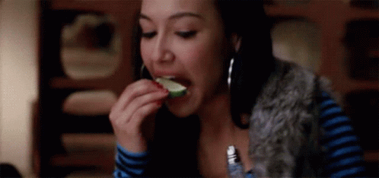
Can you think of any crazy or extreme thing you have done? See if anyone else has done it by using the question “have you ever . . .?” and share your experiences.
NOTE: even though the question is in present perfect, make sure you shift to past or any other tense if necessary.
Example: Have you ever done bungee jumping?

Slide 4
Discuss the following questions with your partner:
How has your experience as a university student been so far?
Who have you met this semester?
What classes have you already passed?
Have you worked out this week? Explain.
What things have you done today?
Have you seen [name a movie] yet?
Have you ever felt discriminated?
What good restaurants/clubs have you eaten/danced at?
Have you changed anything in your room recently?

Slide 5
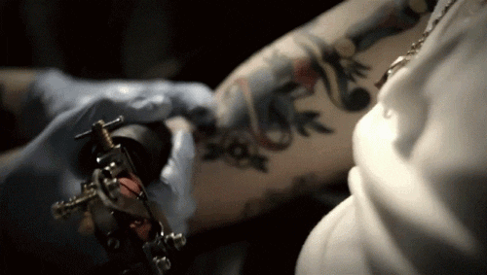
Discuss these extra have-you-ever questions just for the fun:
Have you ever . . .
. . . lied about your age?
. . . hit on someone who was dating somebody else?
. . . worn special clothes to cover up a hickey?
. . . spent the night sleeping by the toilet?
. . . sunbathed partially or totally naked?
. . . got arrested?
. . . not been able to remember how you got somewhere?
. . . cheated on a test or an exam?
. . . used a fake I.D.?
. . . burped while you were kissing someone?
. . . smoked hiding in bathroom?
. . . gotten so sick, that you swore off a particular food or type of alcohol?
. . . had a dream about a classmate or a friends’ girl/boyfriend?
. . . gotten a tattoo?
. . . lied about your birthday just to get a free dessert?

