Slide 1
Inglés Pre Intermedio (CEFL b1)
Regular Verb Pronunciations

Slide 2
There are 2 big verb groups in English:
REGULAR
IRREGULAR
Their conjugation is very predictable.
Just add <ed> when spelling. Some may already have an <e>
For example:
WALK
DISCUSS
FILL
AGREE
ACCEPT
CHAT
Their conjugation into past or past participle is less predictable. For example:
TAKE?
TOOK/TAKEN
SING?
SANG/SUNG
UNDERSTAND?
UNDERSTOOD
BRING?
BROUGHT
READ?
READ
*Some need to change a <y> for an <i> when the <y> is preceded by consonant.
LEARN?
LEARNED OR LEARNT
PUT?
PUT
STUDY
CRY
v.s.
STAY
ENJOY

Slide 3
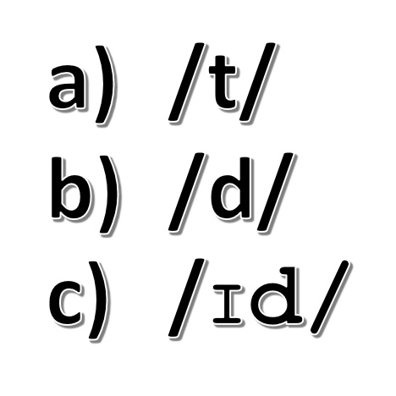
What’s the catch with regular verbs? They may be easy to spell but pronouncing them is a bit tricky.
The final <ed> syllable we add to the spelling can be pronounced in 3 different ways:

Slide 4
Identify all the verbs that
in the form 2 and 3 end in
<ted> or <ded>
For example:
Accept – Accepted- Accepted

Slide 5
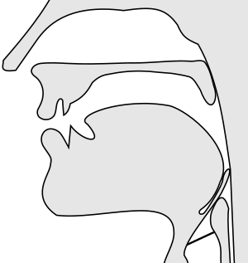
/d-t/
/d-t/

Slide 6
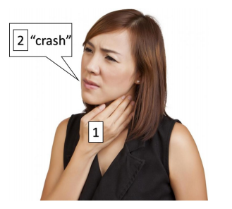
Place your hand on your throat,
Pronounce the verb you are analysing in infinitive (not in past).
Pay attention to the LAST sound you produce. In this case /sh/. If you can’t feel your vocal cords vibrating, it belongs to group A) /t/, but if you actually feel them vibrate, it belongs to group B), as in dare
In the example, the past tense should go like this: /crasht/
For group C), it may be easier to you to look at the spelling. Whenever you end up with a <ded> or <ted> cluster, you know that you must add an entire new syllable in the pronunciation: /Ӏd/. E.g.:
Test → spelled: <tested>, so it’s pronounced /testӀd/

Slide 7
As shown on the previous slide, analyze the final sound of the verbs below and determine the pronunciation of the added <ed>.
cured - healed - injured - operated - prescribed - treated
cleared - picked - dropped - nodded - blinked - sneezed - recovered
swallowed - folded - expanded - stretched - explained - gained
looked - pulled - dried - diagnosed - prevented - dislocated
examined - scanned - touched - moved - x-rayed - tensed
/d/
/d/
/d/
/Ӏd/
/d/
/Ӏd/
/d/
/t/
/t/
/Ӏd/
/t/
/d/
/d/
/d/
/Ӏd/
/Ӏd/
/t/
/d/
/d/
/t/
/d/
/d/
/d/
/Ӏd/
/Ӏd/
/d/
/d/
/t/
/d/
/d/
/t/

Slide 8
Can you say this tongue twister?:
Peter Piper picked a peck of pickled peppers.
Did Peter Piper pick a peck of pickled peppers?
If Peter Piper picked a peck of pickled peppers,
Where’s the peck of pickled peppers Peter Piper picked?

Slide 9
Regular verbs ed pronunciation
The following table explains when to pronounce the <-ed> each of those 3 ways.
When the verb in infinitive finishes in the SOUNDS (NOT LETTERS): /k/, /p/, /s/, /ch/, /sh/, and /f/ the is pronounced /t/, for example: Looked > look/t/ Coughed > cough/t/ Finished > finish/t/ DON’T pronounce an extra syllable: /fi – ni - shed/ (INCORRECT) /fi - nisht/ (CORRECT)
When the verb in infinitive finishes in the SOUNDS (NOT LETTERS): /l/, /v/, /m/, /n/, /b/, /r/ and all vowel sounds, the is pronounced /d/, for example: Smelled > smel/d/ Cleaned > clean/d/ Played > play/d/ DON’T pronounce an extra syllable: /play - ed/ (INCORRECT) /playd/ (CORRECT)
When the verb in infinitive finishes in the SOUNDS (NOT LETTERS): /t/ or /d/, the is pronounced /id/, for example: Wanted > want/id/ Need > need/id/ Grade > grad/id/ Create > creat/id/ In these cases you HAVE TO pronounce an extra syllable: /want – id/

Slide 10
Practice
Cooked
Exercised
Needed
Shopped
Listened
Waited

