Slide 1
Inglés Intermedio
Week 5
Case Studies

Slide 2
CASE STUDY 1 (Handout, p.30)
I. Read the following case, and observe how Mary and John are giving suggestions.
Study Case 1: Scenario: John has an important job interview tomorrow, and he is feeling nervous about it. His friend, Mary, tries to offer some advice.
Mary: "You should prepare well and do your best in the interview."
John: "You're right. I must give it my all and make a great impression."
Mary: “ Also______________________________________________________”
(Create your own suggestions)

Slide 3
Modal Verbs

Slide 4
What are we going to learn?
Learning Outcomes:
-Expressing obligation, responsibilities, advice or recommendation, prohibition, probabilities, something necessary and not necessary using some modal verbs, in a working and personal context.

Slide 5
English B1
Answer the following questions in pairs.
1. What should a person do to keep healthy?
2. What mustn´t a person do to keep healthy?

Slide 6
Modal verb | Uses | Examples
MUST/MUSTN’T | Necessity /obligation Prohibition | You must obey your teachers. He mustn’t drink alcohol.
SHOULD/OUGHT TO | Giving advice or recommendation | You should follow his wise advice. We ought to get some more petrol.
HAVE TO | Essential or necessary External obligation | I have to study this weekend if I want to pass the English exam. She has to pay the electricity bill at the end of the month.
DON´T HAVE TO | Not essential or necessary | He doesn't have to wash Mr. Gordon´s face; he can do it himself.

Slide 7
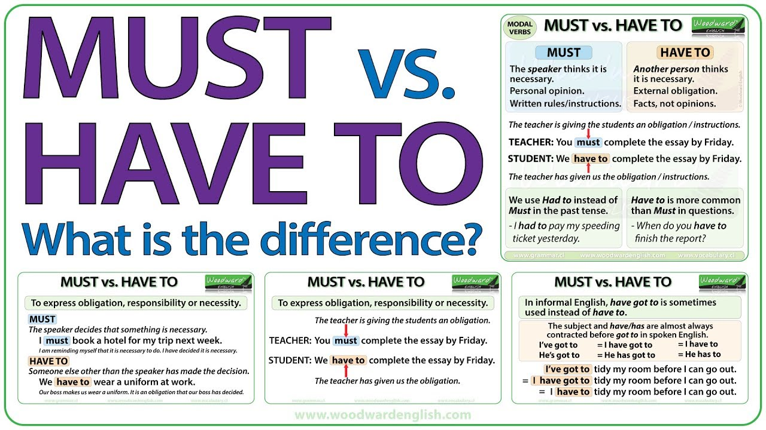

Slide 8
IN THE PRESENT TENSE USE: must or have to/and has to for he, she, and it.
PAST SIMPLE FOR MUST | MUST is only used in Present Simple. We had to go home. We didn't have to go home. Did we have to go home?
Future | He will have to go home. He won't have to go home. Will he have to go home?
Present perfect | She has had to go home. She hasn't had to go home yet. Has she had to go home yet?

Slide 9
Class Activity 2: Role-play (handout,p.31 ) Student A: new co-worker from India. Student B: health care collaborator.
In pairs, advise a new Indian co-worker who comes to live and work in a Latin American country for the first time on what he or she should, shouldn´t , must, mustn´t, have to or don't have to do at work.

Slide 10
Class Activity 3
Group Discussion
Answer in groups the following questions:
1. What should healthcare professionals do to prevent illnesses and diseases?
2. Must doctors be prepared for any type of emergencies?
3. What should governments do to encourage their populations to eat healthily?

Slide 11
SELF STUDY ACTIVITIES

Slide 12
Match EACH MODAL WITH its definition can,should, must,may,have to.
https://wordwall.net/resource/12644908/modal-verbs

Slide 13
Self study:
MODAL VERBS: Positive and negative exercises.
https://wordwall.net/resource/24387548/modal-verbs

Slide 14
SELF- STUDY VIDEO
Must, Have to, Should. (positive). Mustn´t, Don´t have to, Shouldn´t. (negative). (negative)
•https://youtu.be/Xhd1bEVXoZk

Slide 15
Exercises: Must, May, Should
https://wordwall.net/resource/15389477/modal-verbs

